Slide 1
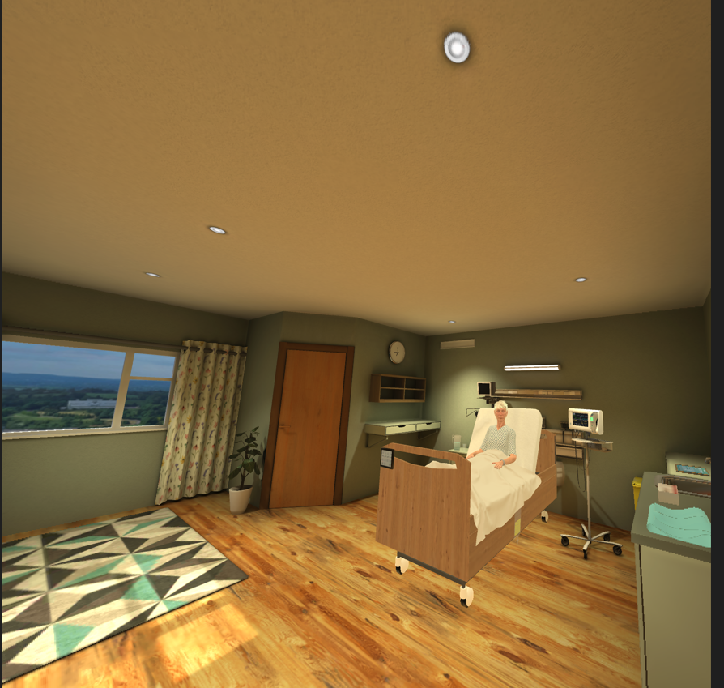
WWETB’s Immersive Hospital Room
Mary Walsh O’Shea

Slide 2
Why use immersive technologies?
How do we use it?
How will it help learning?

Slide 3
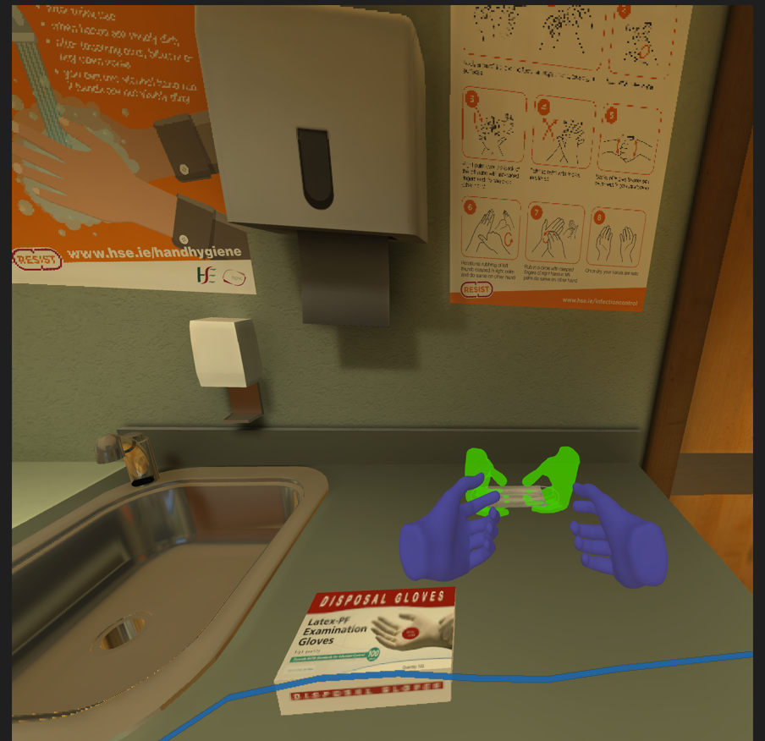
Image of practice session where learner gets guidance to follow the correct step

Slide 4
Image of practice session where learner gets guidance to follow the correct steps 2

Slide 5
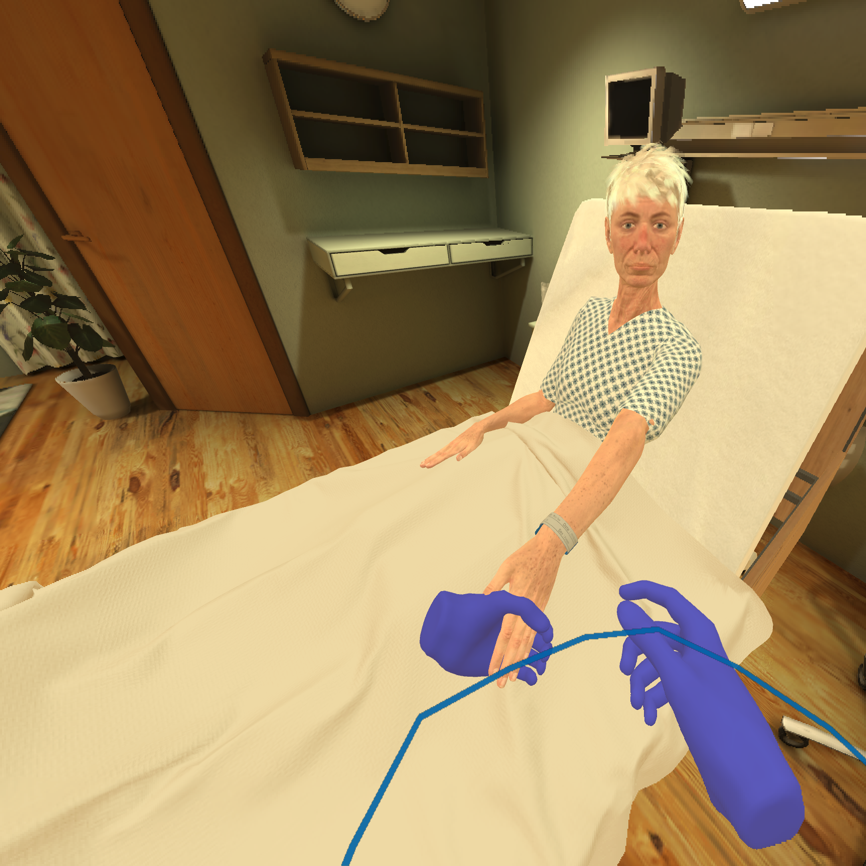
Image of Learner lifting patient’s hand to check ID tag.

Slide 6
Immersive Technologies can we call them assistive technologies?
How can they assist learning?
Where does AI come into Immersive Technologies and what advantages can it bring?

