Slide 1
Key Findings from The WAM Programme
Caroline McGrotty | Employment Manager
AHEAD Research Webinar
12th February 2024

Slide 2
What is The WAM Programme?
Widen access to mainstream employment while working and supporting employers to become more inclusive
Employers offer ring-fenced roles at graduate level
Comprehensive training prior to recruitment and placement
Workplace needs assessment conducted with all graduates
Ongoing support from WAM Team throughout
Graduates get paid work opportunities and experience the world of work in a supported way

Slide 3
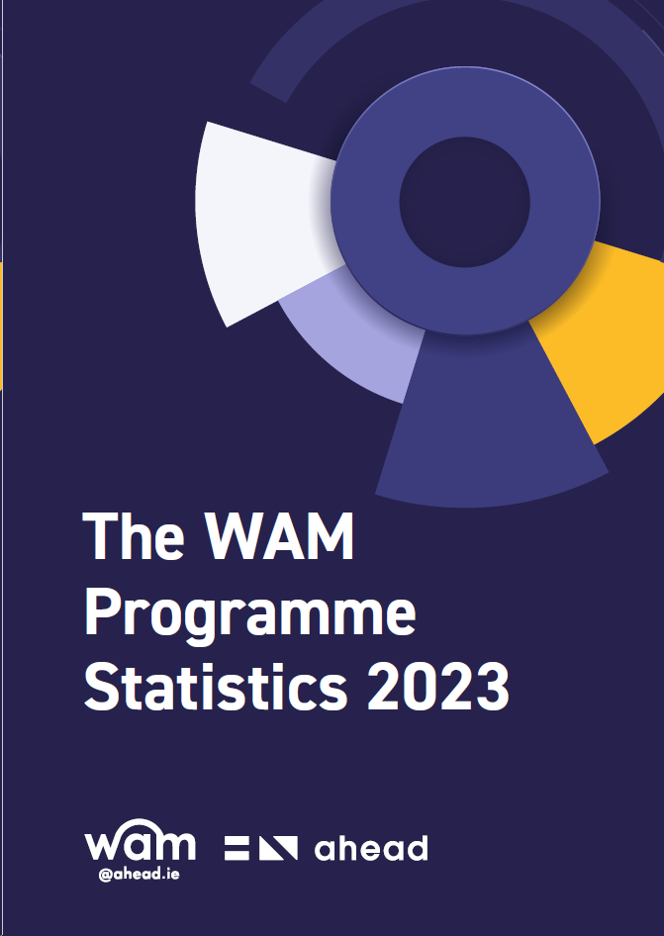
WAM Statistics 2023
Mixed methods methodology using a variety of datasets, including:
Disability profile of 619 placed WAM Graduates
3,665 applications to WAM placements
738 advertised WAM placements
460 workplace needs assessments
Employment transition rates of 238 WAM Graduates
Open-ended comments from WAM Graduates
Download The WAM Programme Statistics 2023

Slide 4
Disability Profile
Notes:
In the early years of the WAM programme, the most common type of disability was physical disabilities. The analysis of disability profiles of WAM graduates over the years also noted that disabilities such as neurological/speech language difficulties, ADD/ADHD, and Dyspraxia/Developmental Coordination Disorder (DCD) were not represented in the WAM programme for the first few years. However, this has changed significantly over the past four years as the demographic of graduates has continued to change
To date, the most common disability of placed WAM graduates is now a mental health condition (20%; n=160), followed by specific learning difficulty at 19% (n=151). The third highest category was represented by significant ongoing illness (14%; n=108) followed by physical disability at 13% (n=106). Autism represented 8% (n=67) as did blind/visually impaired (8%; n=67); deaf/hard of hearing represented 6% (n=44); dyspraxia represented 5% (n=38), neurological/speech and language difficulty at 4% (n=28) and finally ADD/ADHD represented 3% (n=24).

Slide 5
Multiple Disabilities
Over 1 in 3 graduates
22% of WAM graduates
Since the beginning of WAM
Last 5 years of WAM
1 in 10 graduates
First 10 years of WAM
Notes:
In the first ten years of The WAM Programme, on average, 1 in every 10 graduates presented with multiple, or co-occurring, disabilities. However, in recent years, this figure has increased. In the last five years alone, 2018 – 2023, over 1 in 3 graduates disclosed multiple disabilities.
For the majority of graduates, many had varying types of co-occurring disabilities, in some cases, up to five different types of disabilities. However, there also remained others who reported multiple disabilities of the same type (e.g., co-occurring mental health conditions).
Cumulatively, since the beginning of The WAM Programme, 22% (n=135) of graduates reported having more than one disability.

Slide 6
Accommodations in Recruitment
3,665 individual applications were analysed for reasonable accommodation requests across three main areas;
Traditional Interviews (Face to Face)
Virtual Interviews
Testing and Screening

Slide 7
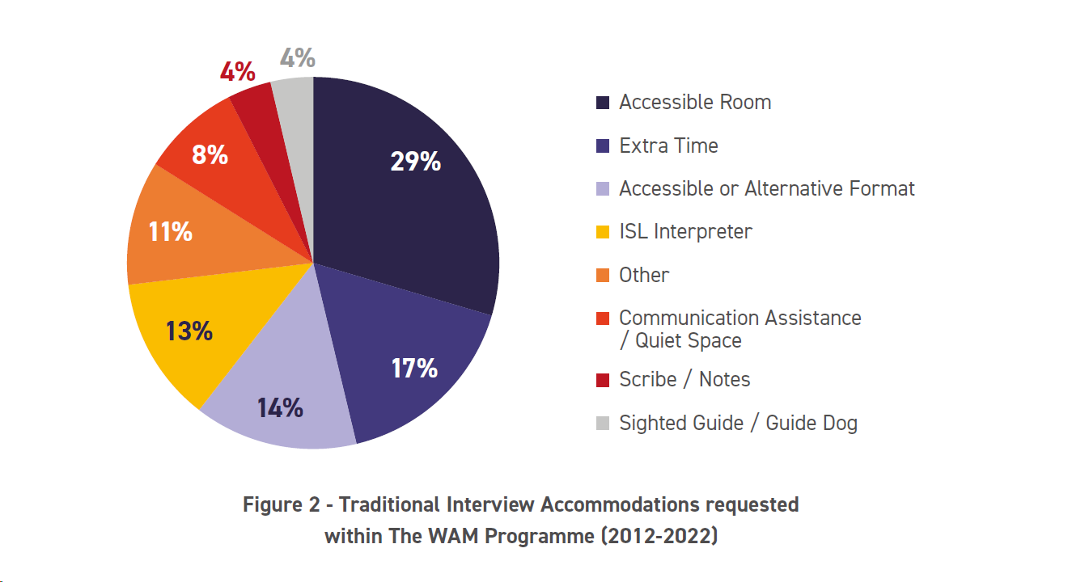
Traditional Interviews
Breakdown of Accommodations
1 in 5 require accommodations for a traditional interview
Notes:
Out of the 3,665 applications analysed, 20% (n=750) of graduates informed the employer about an accommodation or shared additional information for a traditional in-person interview. 80% (n=2916) of applicants did not request or share any accommodations with employers.
This demonstrates that 80%, or 4 out of 5 candidates, who attend a traditional interview did not require any support or accommodations and therefore may have disabilities which are not necessarily visible or obvious to the employer. For example, candidates who have mental health difficulties, dyslexia, or an ongoing or chronic illness generally may not have any requirements for a traditional face-to-face interview, and thus, would not disclose a request for support to enable them to participate in the interview process fully.

Slide 8
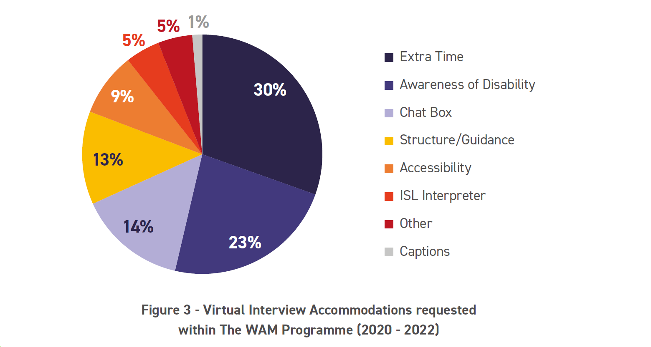
Virtual Interviews
Breakdown of Accommodations
1 in 7 require accommodations for a virtual interview
Notes:
Of 774 applications analysed since 2020, 15% (n=115) of graduates informed the employer about an accommodation or shared additional information for a virtual interview. 85% (n=659) of applicants did not share or request any accommodations for a virtual interview.

Slide 9
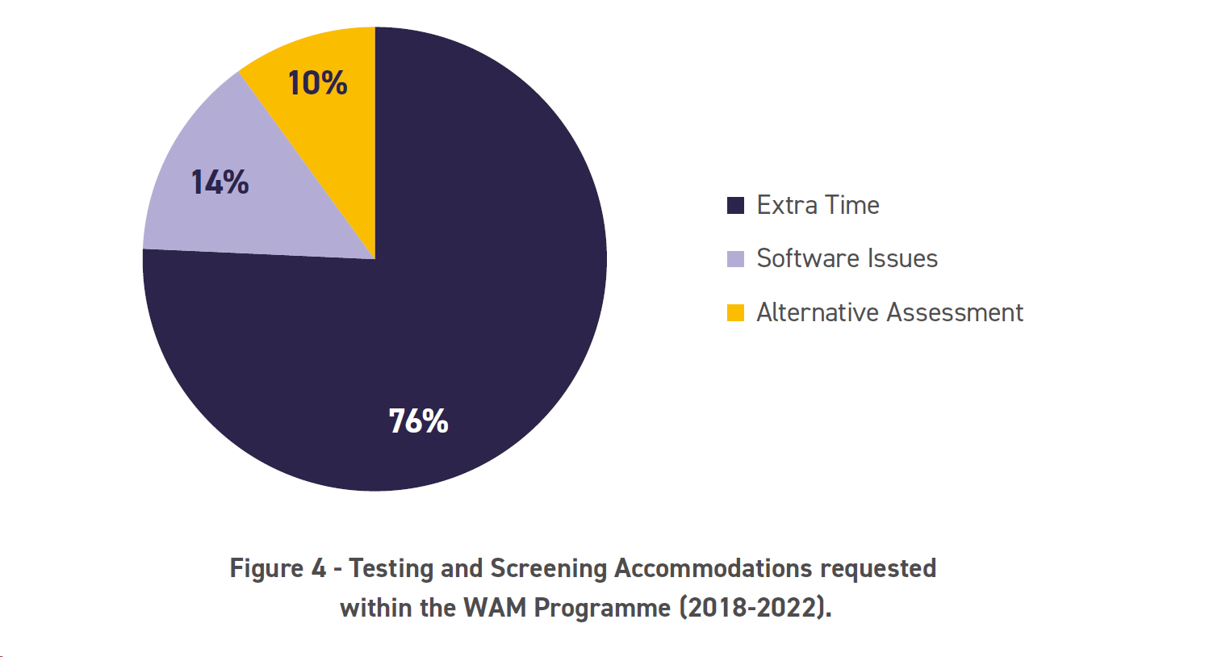
Testing and Screening
Breakdown of Accommodations
1 in 3 require accommodations for testing and screening
Notes:
Of 479 applications to positions that had an element of testing and/or screening in the recruitment process, 33% (n=158) of applicants required support. This includes the use of phone screening, psychometric tests, group assessments, technical tests, or roleplay exercises.

Slide 10
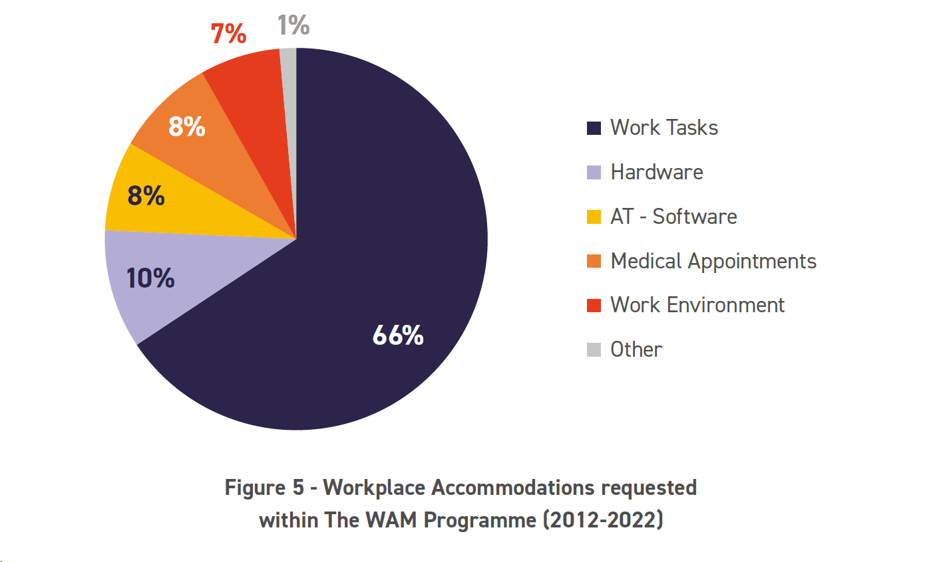
Accommodations in the Workplace
460 needs assessments of graduates were analysed grouped into six categories:
Work Tasks
Hardware
Assistive Technology (Software)
Medical Appointments
Work Environment
Other
Notes:
The majority of workplace accommodations recommended in the needs assessment were in relation to work tasks at 66% (n=1494). The second highest were hardware accommodations (10%; n=229), followed by assistive technology (8%; n=173) and time off for medical appointments (8%; n=193). Finally, work environment accommodations were recommended 7% (n=154) of the time and other additional accommodations at 1% (n=32).

Slide 11
Work Tasks
Notes:
Within the work tasks category, 28% of accommodations were in relation to the manager providing clear structure, guidance, and regular feedback. 15% were in relation to allowing regular breaks or style of communication amongst team members, 10% was a requirement for written instructions from their manager and 9% required an awareness of extra time to complete tasks. Further, within this category, 9% of graduates requested proof-reading or no taking official records of meetings. A further 8% required specific training recommendations, while 7% requested templates for work or a list of commonly used acronyms in the workplace. Finally, 6% requested minimal stress or specific support from the graduate’s mentor, 5% requested documents to be shared in an electronic format and only 3% had a preference to receive verbal instructions.

Slide 12
Work Environment
Notes:
Of the requests for accommodations related to the work environment, 75% (n=116) recommended adjustments to the workstation, which included having a specific location in the office for their desk or having an ergonomic set-up. A further 13% (n=20) requested the option for remote working, 6% (n=9) recommended specific measures to make modifications to the building and 6% (n=9) recommended that the graduate have an assigned desk in instances where a hot-desking policy was in place within the organisation.

Slide 13
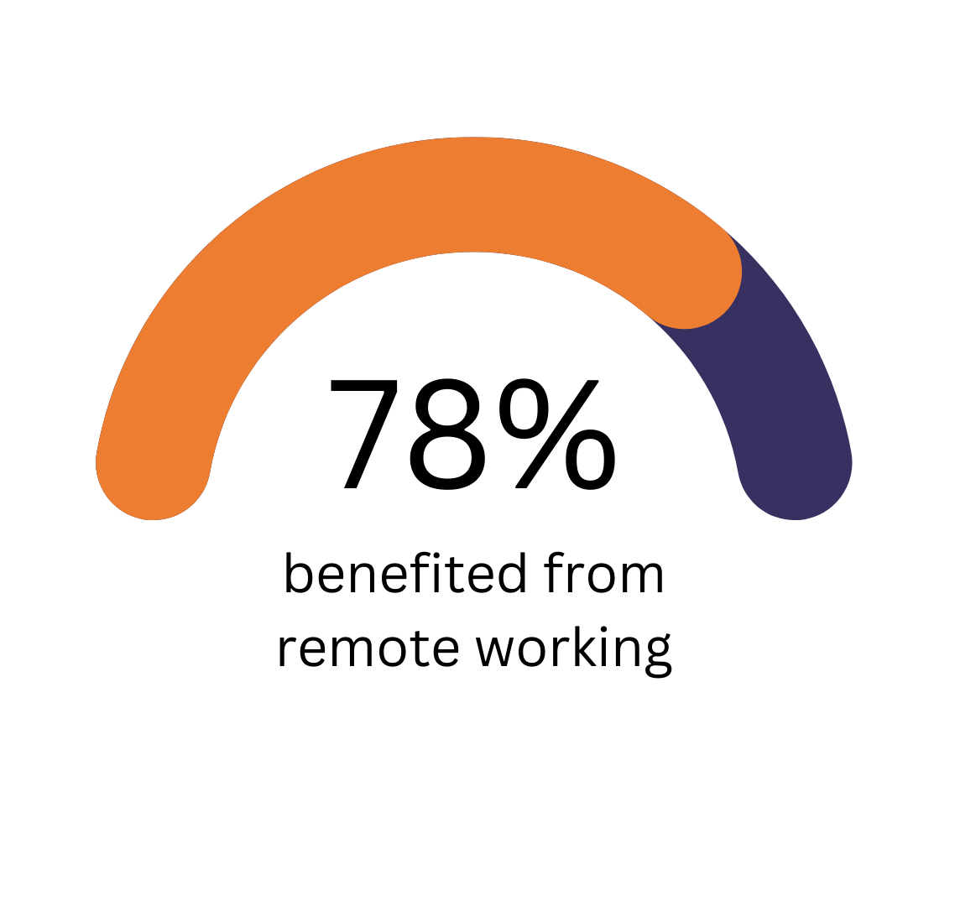
Remote Working
98% of remote working requests were made in 2021 and 2022. Just 3 requests for remote working were made pre-pandemic.
Since 2021, 14% of graduates requested additional remote workdays above employers’ standard hybrid working policies
Notes:
It is important to note that this data only reflects those graduates who made a specific request to remote work as a workplace accommodation.
Prior to 2020, many WAM employers did not have the capacity for staff to work remotely; however, this changed dramatically due to the COVID-19 pandemic
Most WAM employers started to implement hybrid work policies, where they offered some form of remote working for all employees. As such, since 2021, the prevalence of remote working as a reasonable accommodation increased as graduates with disabilities requested the flexibility to work remotely more frequently than the standard hybrid work arrangements employers were willing to facilitate.

Slide 14
Other Accommodations
42% of WAM placed graduates required time off for medical appointments for their disability
Other (1%) accommodations were Irish Sign Language Interpreter, designated car parking space etc.
Cost of disability is hard to predict but we do know that two-thirds do not incur a cost.
Notes:
Of the 460 graduate needs assessments analysed, 42% required time off to attend medical appointments related to their disability. The frequency of medical appointments varied from as little as once per annum to once a fortnight, depending on the nature of the disability.

Slide 15
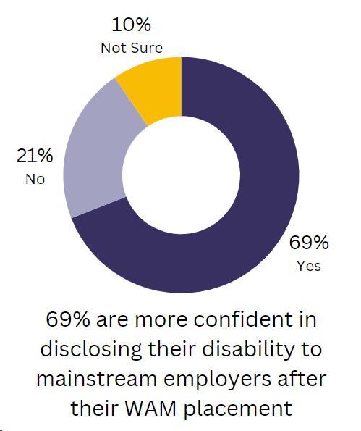
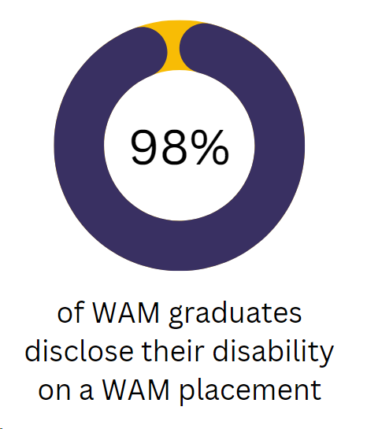
Disclosure
The WAM Programme is a safe space providing graduates the opportunity to try out disclosure in a supported format.
Notes:
Of the 460 needs assessments completed and analysed between 2012-2022, 94% (n=431) of graduates chose to completely disclose their disability or disabilities to their line manager, mentor and to the HR department. Conversely, 4% (n=21) of graduates partially disclosed (e.g., they may have only disclosed one of their disabilities) and 2% (n=8) of graduates chose not to disclose at all.

Slide 16
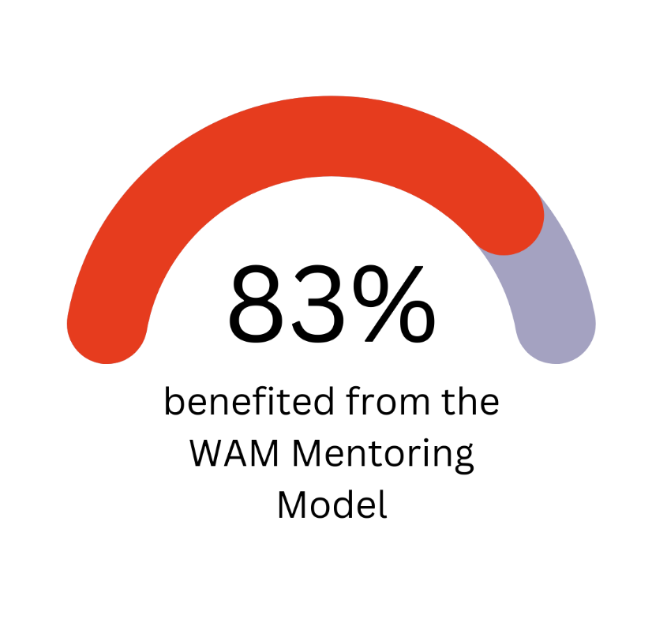
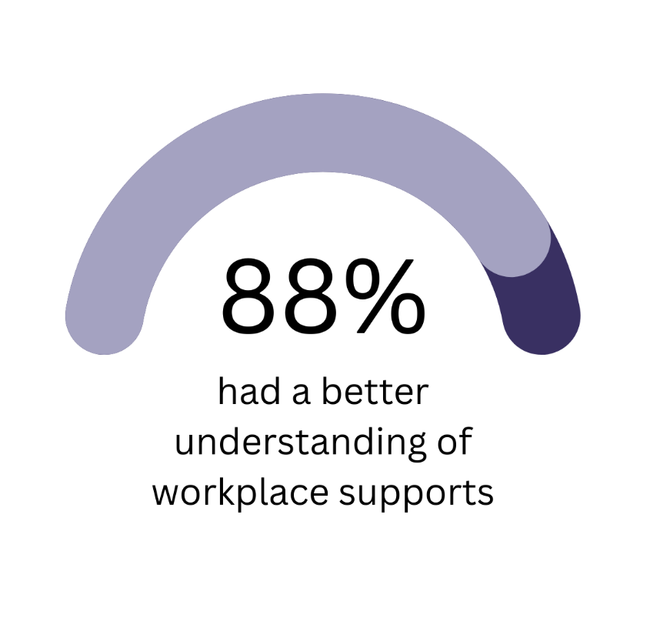
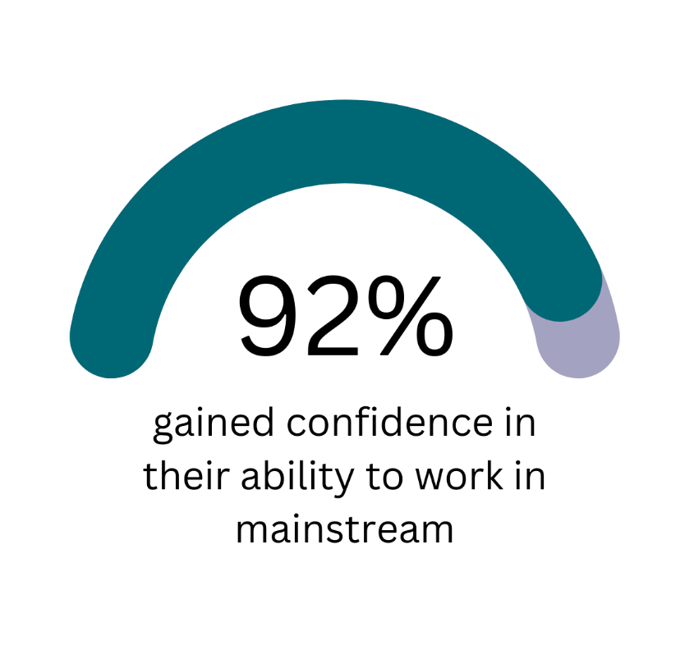
WAM Graduates Rating – Experiences

Slide 17
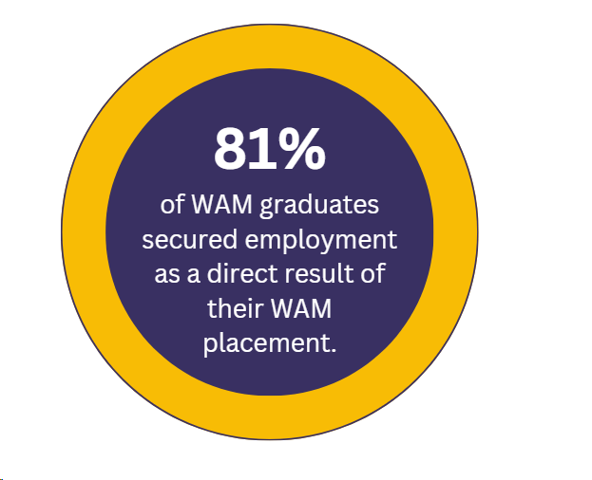
WAM Graduates Employment Rates
69% of graduates are no longer in receipt of any illness or disability benefits
Notes:
Out of 335 graduates, 174 graduates (52%) responded to the survey and a further 64 graduates (19%) were included in analysis as their employment transition rates for the year following their placements were known to the WAM Team. The employment status and progression rates of 97 graduates (29%) remain unknown. At the time of completing the survey and the analysis, 78% (n=185) were currently employed, however 81% (n=193) secured employment as a direct result of their WAM placement.
Other reasons include - out of work for reasons such as ill health, travelling, career break or assumed caring responsibilities, etc.

Slide 18
What our WAM Graduates say…
…it was a game changer for me. It opened my life to a world of possibilities in my career and my disability has never been an issue the supports and the understanding for them have made my life the one it is now.
And finally, the WAM Programme gave me a life and a career.

Slide 19
Final Slide
The WAM placement genuinely changed my life, I was stuck on Disability and now I am back in the workforce in a field I am passionate about with a company that is supporting me.
I gained so much confidence in speaking about having a disability and have even joined my company’s disability support group.
Download The WAM Programme Statistics 2023

