Slide 1
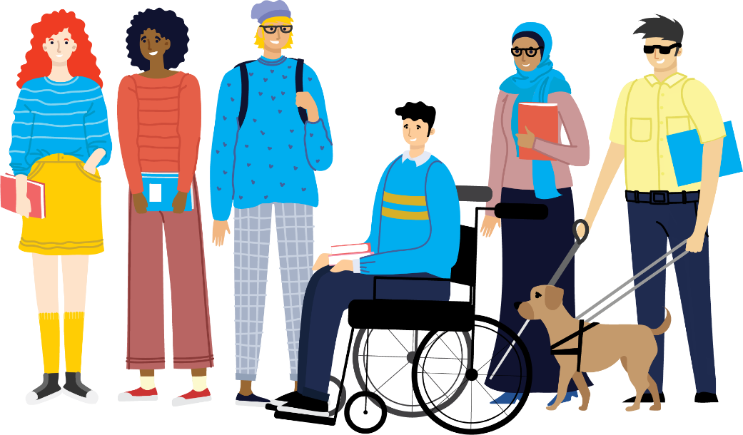
Key Insights from Changing Landscapes
Dr Richard Healy Research and Policy Officer

Slide 2
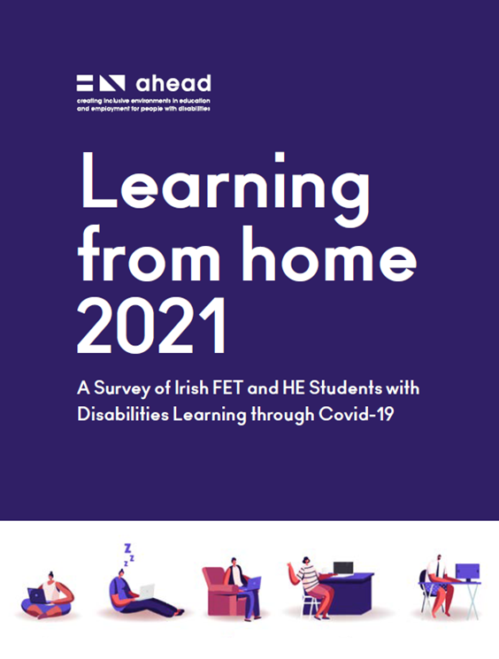
Changing Landscapes —New Experiences
Mixed Methods
3 Lockdown/ Post-Lockdown Studies
1506 students
Notes:
Diversification and changing narratives would usually be long term research..doesn’t occur in a vacuum, rather it is linked to broader economic, cultural and societal contexts. Lockdown enabled researchers to explore diversity..and the response of educators over a short period of time.
Changing Landscapes was the last of three reports that unpacked the experience of disabled students, during and immediately after “lockdown learning”.
3 Lockdown/Post Lockdown Studies of Disabled Student Experience:
Apr 20 – Survey – 601 participants
Apr 21 – Survey – 729 participants
Apr-Sept 22, Survey (175) and Qualitative Interviews (9)

Slide 3
In this session
The challenge of the pandemic was, at its roots, about accessibility and flexibility.
What happened during the pandemic to change how students with disabilities preferred to learn?
Did any lasting change emanate from Pandemic learning, or are we returning to pre-pandemic norms?
Notes:
This presentation explores the changing experiences of accessibility, both during and post-COVID.
Also explores the capabilities, practices and culture (Student Success) of educators, in responding to abrupt, demanding change..
UDL mention—AHEAD are vocal advocates…examine the increased use…

Slide 4
Pandemic Research…Why?
The pandemic was an ideal microcosm that explored the capabilities of lecturers and institutions regarding ease of engagement, the provision of accessible teaching materials and in assessment.
It advanced new ways to understand how students with disabilities navigate tertiary education.
Despite a challenging time, many of the practices that emanated from lockdown learning were suited to the needs to disabled students.
Notes:
WHY IS PANDEMIC RESEARCH RELEVANT TO UDL???
1. UDL was magnified during the Pandemic. Many of the innovative teaching practices that were employed to overcome the many challenges synonymous with lockdown learning were conducive with UDL.
2. Shift from traditional learning to online (abrupt) and the return…post lockdown learning..
3. Learners naturally have different characteristics, preferences, needs, and abilities. The Pandemic amplified this.
4. UDL is a key pedagogical tool that facilitates diverse learning preferences and styles through the provision of alternative means of engagement, representation and expression, (Evmenova, 2021; Fovet, 2020).

Slide 5
The challenge of the pandemic was, at its roots, about accessibility and flexibility.
Notes:
Both are key tenants of UDL. Student/learner experience was, for a short period, very different from the norm.
Both are also argued to be the challenges of diversification
Our research explored choice, accessibility, AT and the different modes of learning during this period. All are in some way related to the principals of UDL.
This broad range of experiences and narratives highlight that learning is non-uniform and is different for all students. Learners naturally have different characteristics, preferences, needs, and abilities. Such individual features may affect their academic performance and learning experience. According to Burgstahler (2011), learner diversity also comprises physical, visual, hearing, sensory, attention, and communication impairments.
With its emphasis on flexibility, choice, agency and autonomy, the practice of UDL helps alleviate some of the more pressing issues that have emerged due to the diversifying of the student body in Ireland in recent times, (Davies et al., 2013).

Slide 6
2020/21 Key Theme – Mixed Experiences & Desires
Most questions split - slight majority/significant minority dynamic.
Increase in student’s coping & AT use, accessibility improvement.
Highlights diversity in community – different needs, circumstances experiences and desires.
Notes:
2019/20 research comparison: sense of unease, worry etc has dissipated…also corroborated by academic lit. (Timonson etc) Still a challenging time..
HEA 2023: the number of mature students (26%), 11% students with children and disabled students have all increased substantially since 2007. More students are now employed and there has also been a significant increase in the hours students work, arguably due to the continued rise in the cost of living, (HEA, 2023). The structure of courses and programmes should reflect this societal change, thus making the attainment of high demand qualifications accessible for all.

Slide 7
2021/22 Key Themes: Student Preferences, AT and Choice
Changing preferences in how students desired to learn.
Sustained increase in the use of AT
Decrease in student’s evaluation of the accessibility of learning materials
Notes:
Changing preferences in how students desired to learn.
Sustained increase in the use of AT—representative of a 100% increase from our initial LFH research
The Changing experiences of students and learners over the course of the research

Slide 8
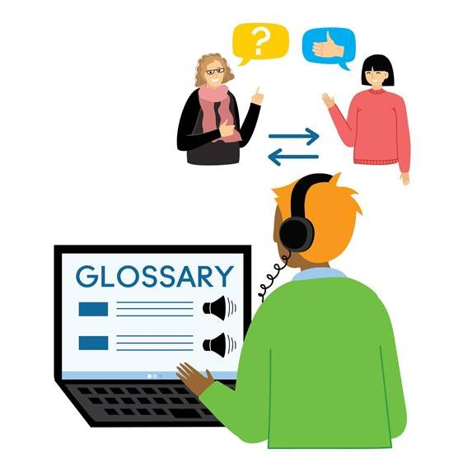
Mode of Engagement – Changing Preferences
Preferred Mode | 2021 | 2022
Mostly in-person learning | 50% | 33%
Blended – mix of in-person and online activities | 39% | 56%
Mostly online | 9% | 12%
Notes:
Majority of students prefer blended learning (56%)…it is also now the most accessible learning mode (according to our cohort 51%)
Have the changes that emerged from lockdown learning led to more choice, have they made a difference to how students experience their studies?

Slide 9
Accessibility 21/22’ – move away from online learning
Notes:
Experiences of accessibility are changing, the emergence of blended learning as preferred (56%) and accessible (51%) mode of learning

Slide 10
Accessibility of Learning Materials 20/21>21/22
Notes:
Return to post lockdown learning corresponds with decreased perceptions of the accessibility of learning materials
Why? Less emphasis on accessibility? potential challenge of combining modes of learning in accessible format?
Are we witnessing a move away from UDL practices post lockdown?

Slide 11
Post Covid Choice in Learning Delivery 21/22
Notes:
Our new research suggests that despite students becoming more comfortable, confident and now preferring blended learning, there has been a slow creep back to pre pandemic norms ands

Slide 12
On the Ground Post Covid 21/22

Slide 13
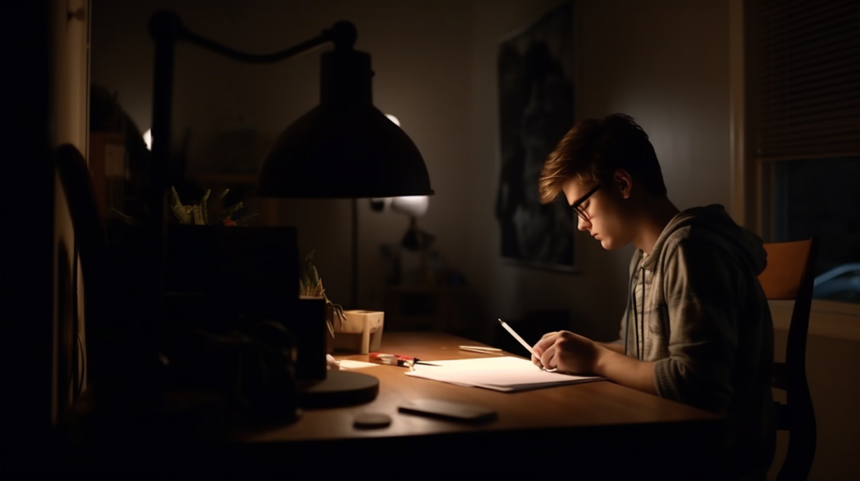
Questioning the exam
Student Voice
“Allowing students with accessibility issues to have access to recordings, audio or video, doesn't give them anything extra that an able body student doesn't already have. It helps level the academic playing field for them.. It's a small thing that could help further improve lives and careers of people with disabilities”.
Student from Survey (2021/22)
Notes:
Student quotes that provide an overview of changing experiences
For a short period, innovative teaching, UDL, increased emphasis on accessibility and flexibility became more common.
Improving accounts suggests that educators were becoming more competent/skilled at inclusive teaching.

Slide 14
How exams disadvantage students with disabilities
“…colleges need to understand that we all learn different, because the one module I got an A in last semester, (in) everything else I scraped a pass, or I just about failed. There was one module, I got an A in, it was a lecturer who was really involved with universal design for learning. She gave a lot of freedom in our topics and the ways we were assessed, the formats we used. And it really, really suited me. I really excelled; I would have liked more choice around everything else”. (Tara)

Slide 15
The Advantages of UDL, Choice and Blended Learning
Changing demographics – newer flexibilities required
Personal demands on students changing
Cultural shifts in expectations
Can help level the playing field for students with disabilities.
Despite this, our research suggests a slow ‘creep’ back – missed opportunity to re-imagine teaching and learning?
Notes:
A recent report by the HEA states that the number of mature students (37%), students with children (11%) and disabled students (273% increase) have all increased substantially since 2007.
More students are now employed and there has also been a significant increase in the hours students work, arguably due to the continued rise in the cost of living, (HEA, 2023).
If tertiary education is to respond to this adequately, through the establishing of accessible pathways both into and through education for these students, blended learning should be developed, and its practice retained.
This should be accompanied by UDL. It is imperative that the structure of courses and programmes reflect societal change, thus making the attainment of high demand qualifications accessible for all.

Slide 16
Time to Reflect!
Has anything from this session particularly resonated with you and your educational experience?
Are there issues raised here that you would particularly like AHEAD to consider conducting national advocacy on?

Slide 17
Thank You For Listening!
Dr Richard Healy
AHEAD

