Slide 1
Leadership in Universal Design
For Tertiary Education
Laura Hegarty
Atlantic Technological University (ATU)
Margaret Finch
Munster Technological University (MTU)

Slide 2
Leadership in Universal Design For Tertiary Education (2)
This course development (under PATH 4- Phase 1) came from the identification of senior leaders wants and needs:
The want to have a unified understanding of universal design (UD) frameworks and opportunities to share effective practice.
The shared commitment to creating inclusive education environments that afforded smooth transitions and pathways for all students to experience inclusion and right of place as they strive to reach their potential within tertiary education.
The want to strategically embed UD across all areas of function within tertiary education to support individual staff actions to be sustainable in impact for students and staff both within and outside classrooms.

Slide 3
Leadership in Universal Design For Tertiary Education (3)
This national commitment was and is visible in the participation of the 19 further education, higher education institutions and tertiary education stakeholders who have brought the course to its point of launch in late April 2024. This is further evidenced in the presence of todays’ Leader Panel.
As is highlighted within the Altitude Charter the role of Senior Leaders is vital as a key strategic enabler to enhancing in a sustainable way UD actions and strategic planning withing our education systems to create truly inclusive environments – ‘Leaders modelling and visibly supporting UD’.

Slide 4
Leadership in Universal Design For Tertiary Education (4)
This course provides a key opportunity to standardise and share the language of UD and its practical application within our systems to have immediate and sustainable impact for students and staff.
The course is an open resource to all with a strategic role within tertiary education progression. The course provides both theoretical frameworks and practical exemplars of 'How to’.

Slide 5
Leadership in Universal Design For Tertiary Education (5)
The launch will provide participants with a direct link to the course no matter what institution you are based in or what LMS your place of work uses.
The course will take approximately two hours and can be accessed in one’s own time at one's own pace with an option to attain a Digital Badge.
The course itself has three core themes:
An introduction to UD inclusive of UDL
An exploration of a strategic management implementation approach to enhancing UD at an organisational level
Practical examples of UD application across the pillars within different offices of function in tertiary education

Slide 6
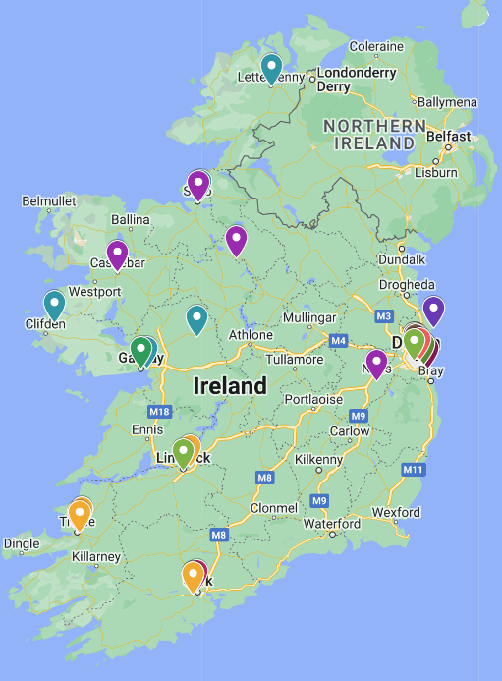
The Power of Collaboration
The enhancement of a national UD narrative through shared understanding and learning.
Working nationally together facilitated the sharing of expertise and learning which creates a sustainability to UD actions and impacts by dissemination outside of traditional silos.
Creating cross project links with each of the projects presented today for further national collaborations - together we can do more.

Slide 7
Next Steps
Launch April / May 2024
First year iteration with feedback opportunity in built
End of first year review evaluate and update

Slide 8
Contributors
Mairead McCann ATU mairead.mccann@atu.ie
Laura Hegarty ATU laura.hegarty@atu.ie
Margaret Finch MTU margaret.finch@mtu.ie
Aileen Kennedy MTU aileen.kennedy@mtu.ie

