Slide 1
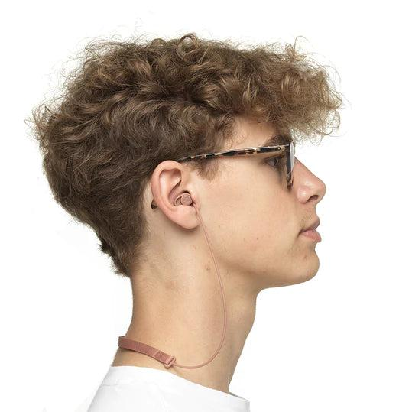
Volume Adjustable Earplugs
Control The Noise with…
DSA Approved Product

Slide 2
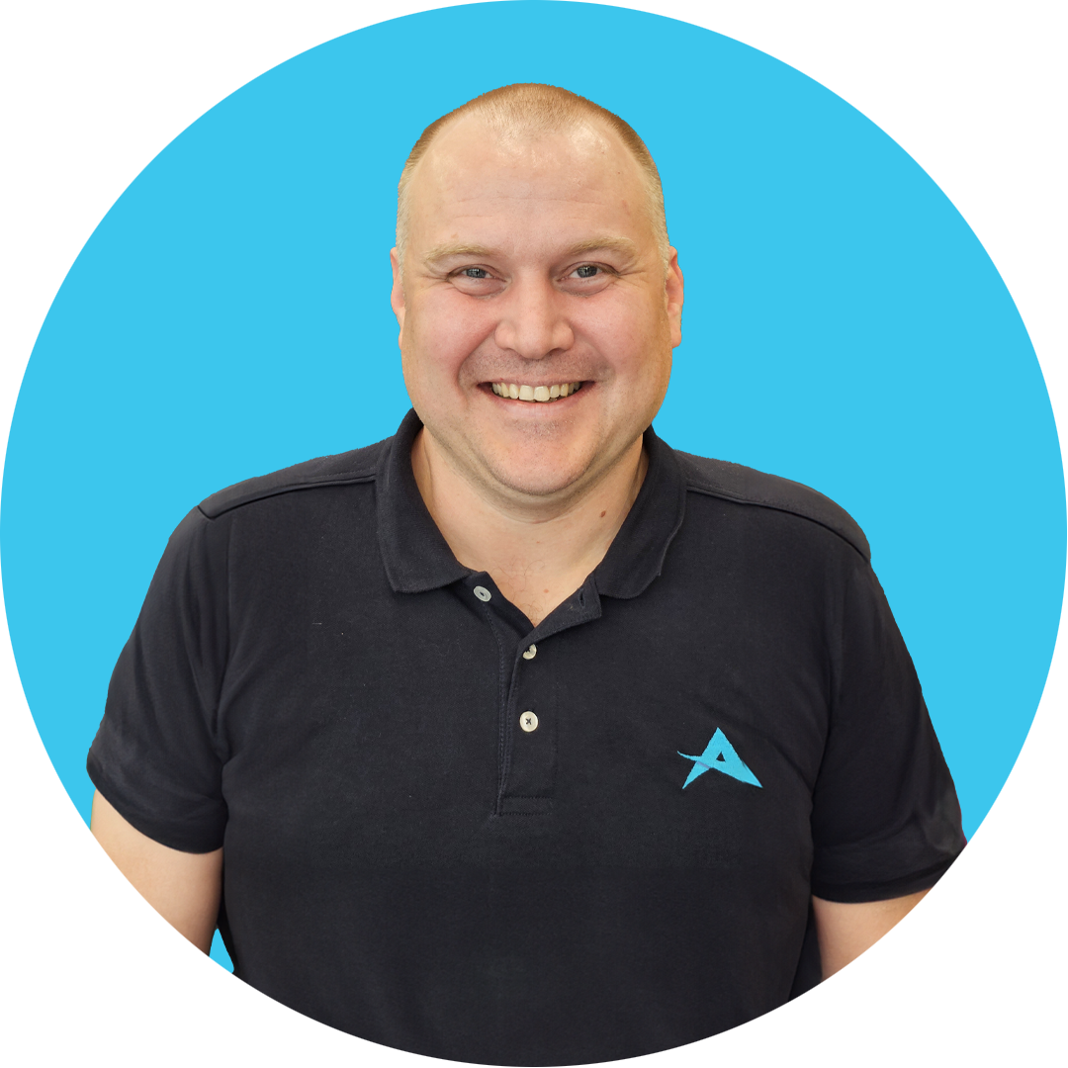
Introduction
About Aventido
Value Added PR and Global Distributor of Assistive Technology
Disabled Students Allowance
Access to Work Scheme
Education sector
https://www.aventido.com/
Ryan Peacock - Product Specialist
dBud Volume Adjustable Earplugs
Bright BSL
MindMeister
MeisterTask
Over 10 Years Experience in DSA - Needs Assessor

Slide 3
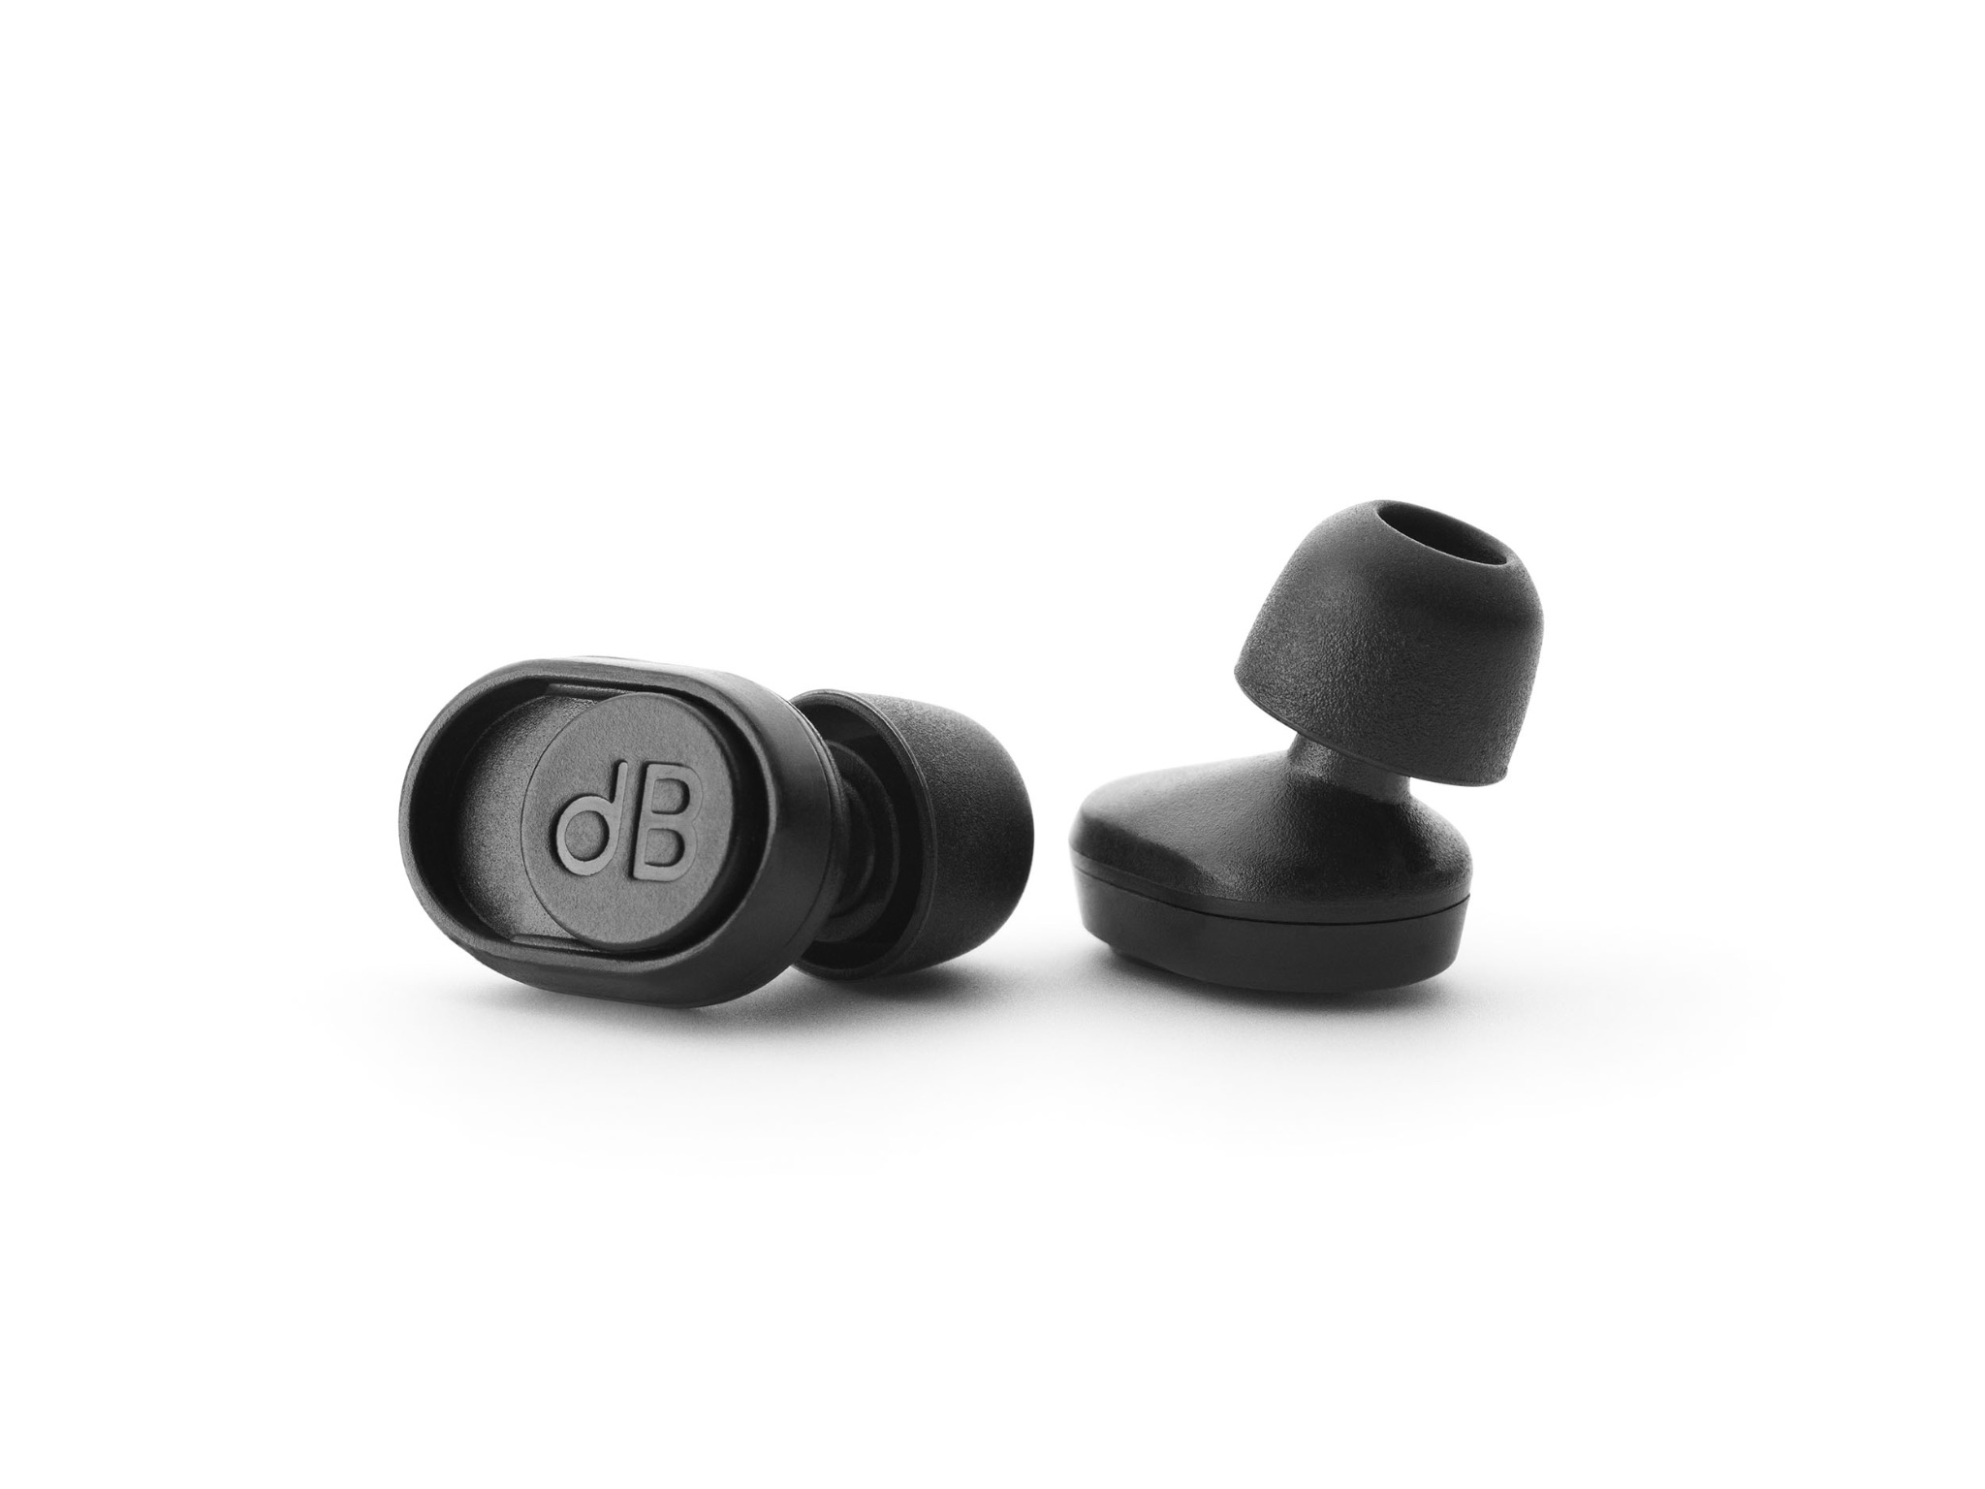
Volume Adjustable Earplugs
dBud Volume Adjustable Earplugs can be recommended to support any individual, such as those with autism, ADHD, or sensory processing disorders, by providing a means to regulate and control their auditory environment.
These individuals often experience heightened sensitivity to sensory stimuli, including sound, which can be overwhelming and lead to sensory overload or anxiety.
The solution!
dBud Volume Adjustable Earplugs offer two selectable levels of attenuation, -12dB and -24dB, allowing the user to adjust the settings depending on their environment.

Slide 4
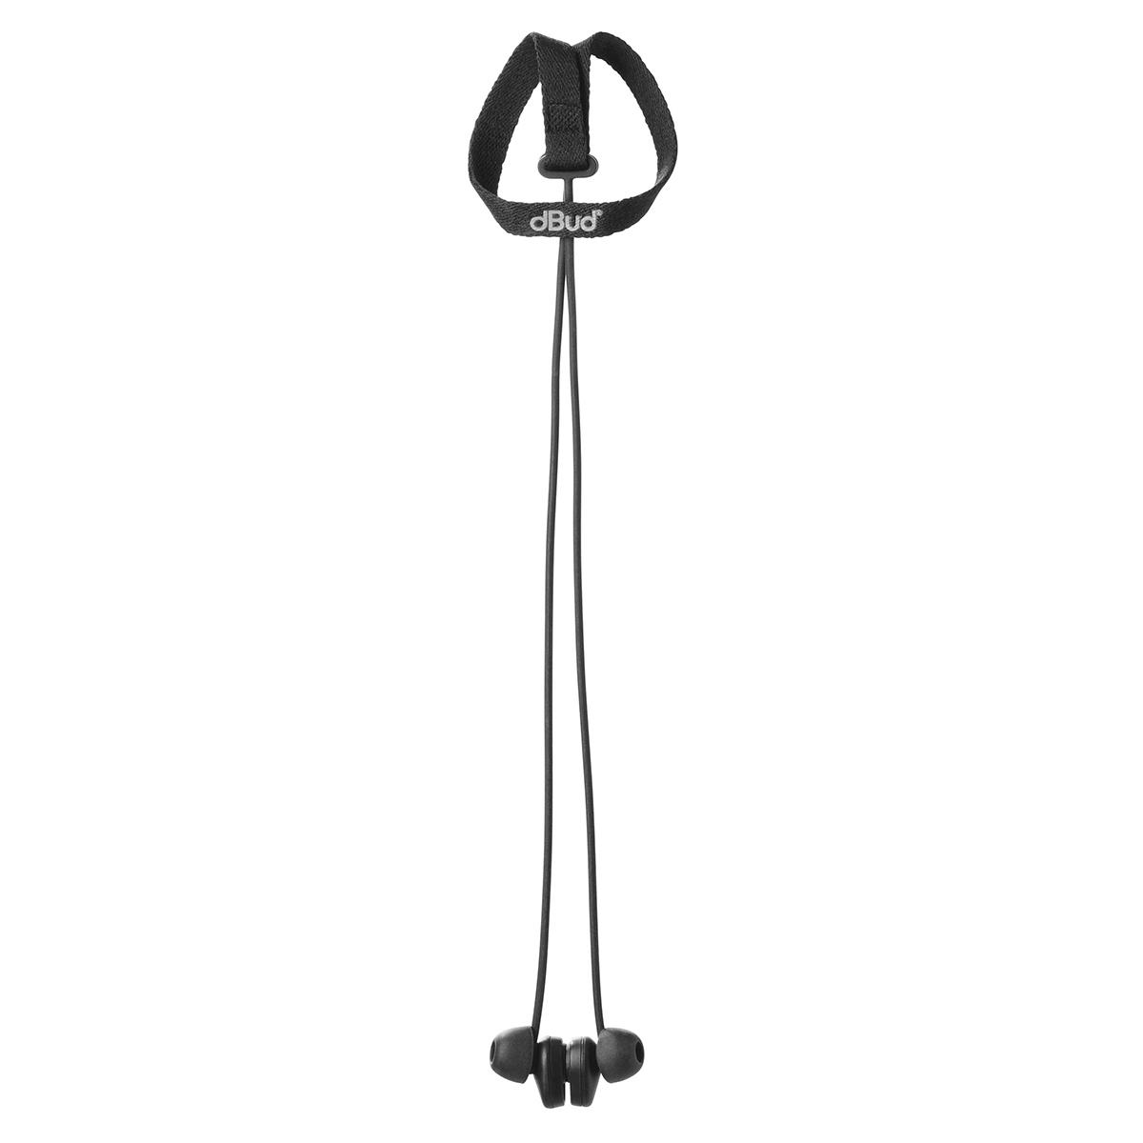
Product Features
dBud Volume Adjustable Earplugs can serve several purposes in those who experience noise sensitivity:
Noise Reduction: dBud Volume Adjustable Earplugs can help reduce or block out excessive noise.
Sensory Modulation: dBud Volume Adjustable Earplugs can serve as a tool for sensory modulation. Neurodiverse individuals may use them to self-regulate their sensory experiences.
Increased Comfort: For many neurodiverse individuals, dBud Volume Adjustable Earplugs can provide comfort and a sense of security.
Decreased Anxiety: By reducing sensory overload, dBud Volume Adjustable Earplugs can help lower anxiety levels in neurodiverse individuals.
Enhanced Focus: dBud Volume Adjustable Earplugs can help individuals with attention and focus difficulties by minimizing distractions.
Notes:
1. Making it easier for individuals who are sensitive to sound to concentrate, relax, or engage in activities without feeling overwhelmed by auditory input.
2. When they feel overstimulated or anxious due to noise, they can insert earplugs to create a quieter, more controlled environment.
3. By reducing the intensity of auditory input, they can feel more at ease in various situations.
4. making it easier for them to participate in social activities, work, or educational settings.
5. and allowing them to concentrate on tasks or activities.

Slide 5
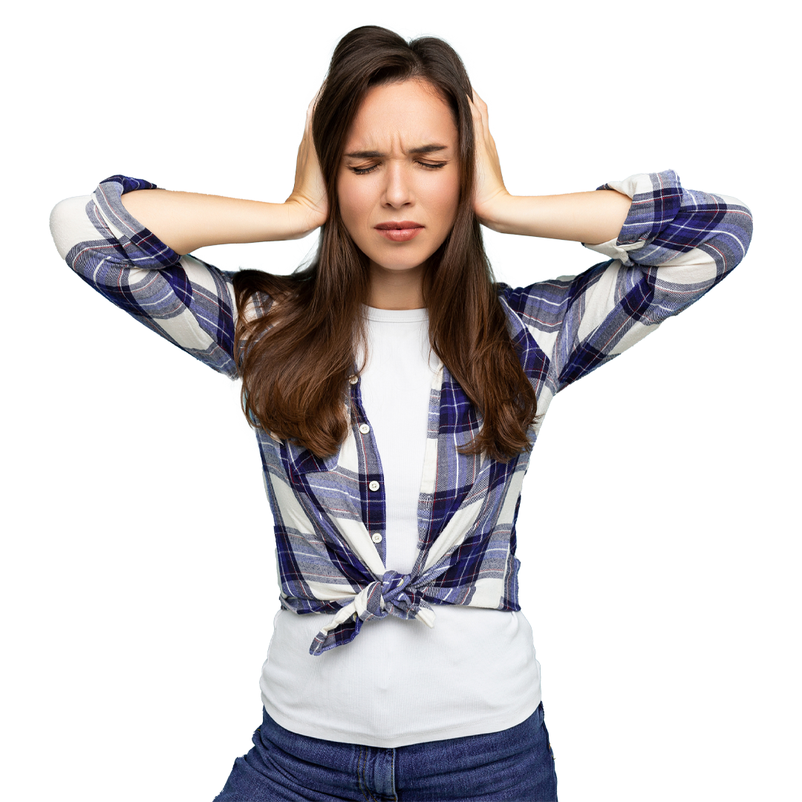
Sensory overload
What is sensory overload?
‘’Sensory overload is when one or more of your 5 senses take in more information than your brain can process.
When your brain is overwhelmed by this input, it enters fight, flight, or freeze mode in response to what feels like a crisis, making you feel unsafe or even panicky.’’
Common symptoms of sensory overload
Difficulty focusing
Extreme irritability
Restlessness and discomfort
Heightened levels of stress and anxiety
Heightened sensitivity levels
Associated conditions
ASC
ADHD
Sensory processing disorder
Post Traumatic Stress Disorder
Fibromyalgia
Multiple Sclerosis (MS)
Chronic Fatigue Syndrome

Slide 6
Noise Sensitivity
What is noise sensitivity?
‘’Noise sensitivity refers to an individual’s heightened or exaggerated response to sounds”
Common symptoms or impacts associated with Noise Sensitivity:
Sensory overload
Overwhelm
Mental fatigue
Attention and concentration
Engagement
Processing speed
Stress
Anxiety
Misinterpretation
Misunderstanding
All of the above can have a negative impact on an individual's ability to fully engage at school, university or in the workplace.

Slide 7
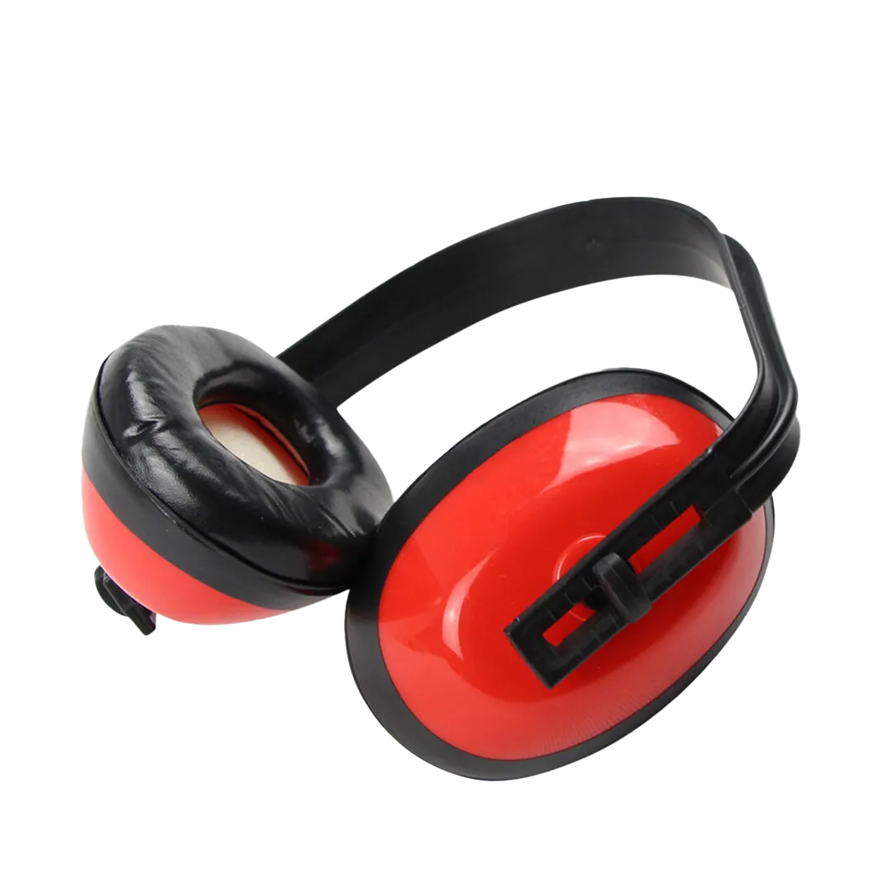
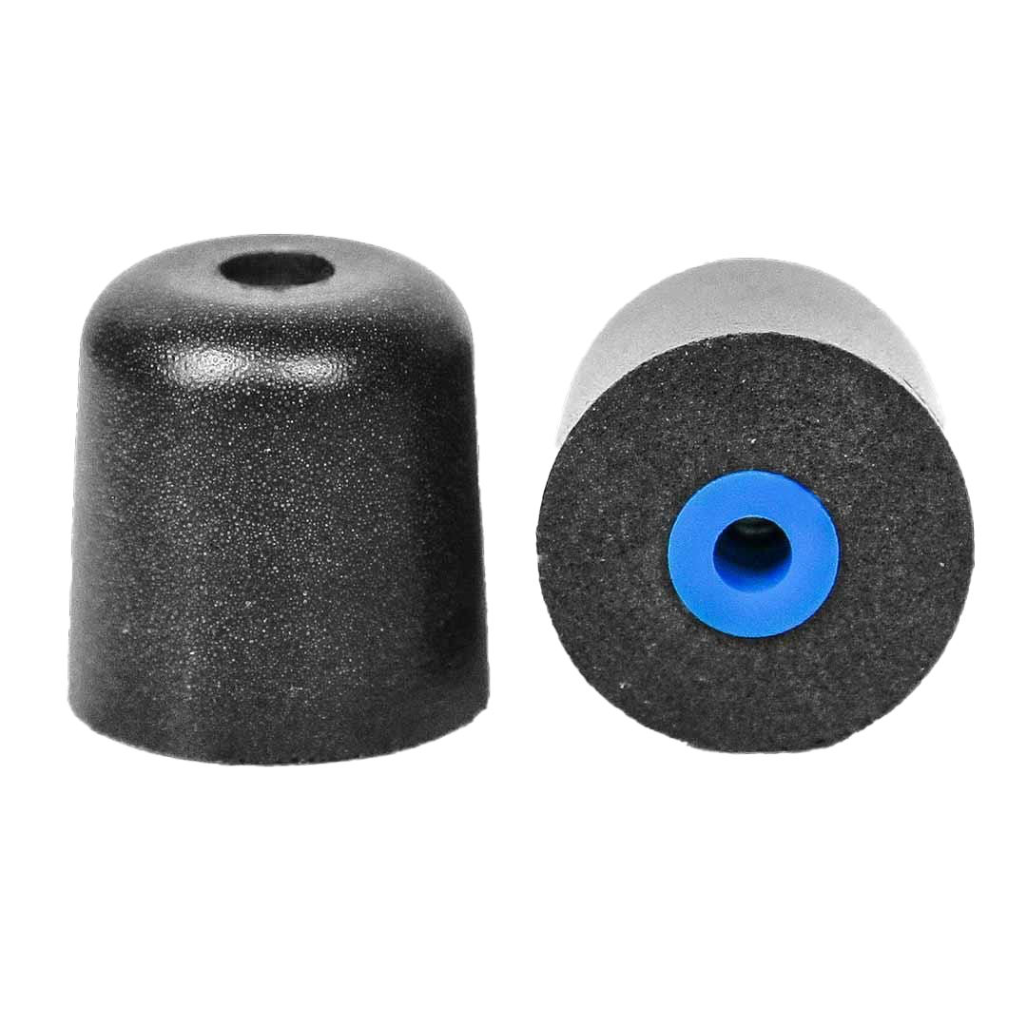
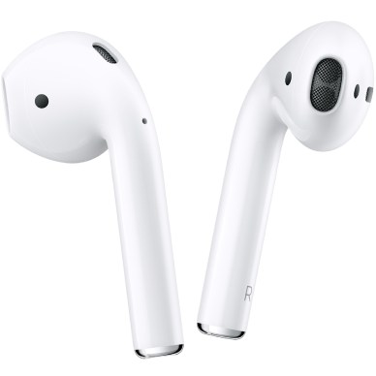
Traditional Solutions:
Noise that makes it difficult to focus
Children with ADHD and Autism struggle with sensitive hearing, which causes both concentration issues and loudness discomfort.
Sara: - sounds that aren’t very loud at all can feel annoying or upsetting, and make these children constantly lose their focus in class.
TOO BULKY AND INDISCREET
Examples:
The sound of pencils on paper
The tapping on laptops
Flipping pages in a book
Subtle chatting in group-work
Somebody going to the bathroom
TOO EASY TO LOSE
Uncomfortably loud
The noise levels at the IES are usually kept to a good, manageable level! but of course it can get loud when large groups are gathered at the same time. For example, the corridors between classes, and lunchtime in the school canteen, can feel very uncomfortable for children with sound sensitivity. This often becomes and anxious struggle, instead of a relaxing break with their friends.
PHONES NOT ALLOWED IN CLASS

Slide 8
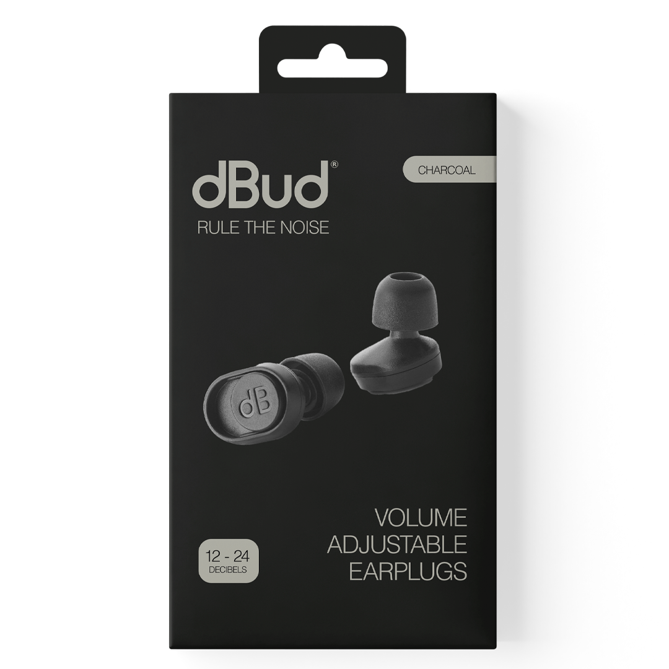
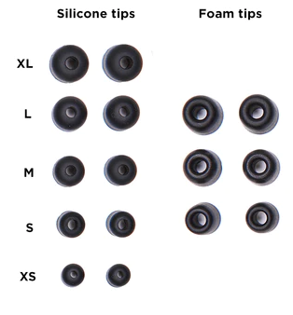
What does the product include?
What’s in the box?
x1 Pair of dBud earplugs
x3 Pairs of memory foam eartips (S,M,L)
x5 Pairs of silicone eartips (XS,S,M,L,XL)
Attachable leash
Carrying case

Slide 9
Colour Ways

Slide 11
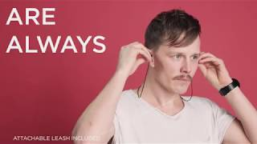

Slide 12
Acoustics

Slide 15
Case Studies
Female, 40 Years Old, diagnosed with high functioning (Hf) autism in 2018 and ADHD. Chronic health issues, including Long QT Syndrome, Depression, Neuropathy and Fibromyalgia.
Presenting issues: Sensory Processing Issues and related. I get very overwhelmed and tired when there are lots of sounds and noises, in particular in busy environments such as by a main road, in halls with lots of people, cities and bustling places.
Summary: In conclusion, really impressed with this product and amazed at how much they can help with filtering out sounds and the subsequent reduction in stress and anxiety; anything to make life easier for a neurodivergent person in a neurotypical world is a positive thing!
Male, 12 Years Old, diagnosed with ADHD and ASD.
Presenting issues: He has severe sensory needs that means he struggles to be in loud places without the use of ear defenders or similar. How loud noises were, he did not like to be seen with his ear defenders on as he does not want to look different to others
Summary: They have made a significant difference to how he feels as he does not stand out to others, like when wearing ear defenders. They have reduced the impact on him when in noisy places. He really likes to wear them and likes that he can have them around his neck in case he needs them.

Slide 16
Example Funding Body Query
"I am emailing regarding the request for the dBuds, i appreciate this is something that will help the student, however why does it need to be this specific pair, there are other cost effective equipment that do the same as what these will do and therefore I would need justification as to why other alternatives are not acceptable and which ones had been discussed and why they were not acceptable to help support the student."
Response
‘’In Student X's case I think that she would need the higher specification pair as she will use them in study environments with different noise levels because of the nature of her course and the institution where she studies. The dBuds provide two different sound dampening levels and having reviewed the product and spoken to someone at the company I think that one level would work for quieter areas such as the library whilst the other level would be needed for time spent in louder performance spaces and studios.
Other solutions appear to do something similar but pricewise I think that it might be more expensive than the dBud’s and it does not appear to provide as much differentiation in the sound level that it can reduce. Please can the dBuds be approved in this case and I will try to ensure that I provide more detail and differentiate between products for future students.’’

Slide 17
How to do I purchase a pair of dBud’s?
dBud’s are available through the DSA and ATW scheme.
dBud’s can be purchased directly through Aventido.
Contact Ryan for more details.

