Slide 1
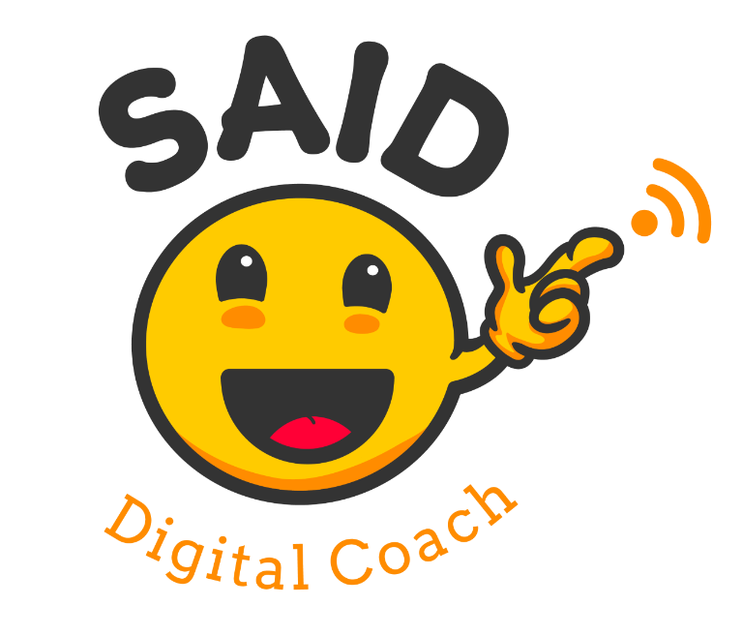
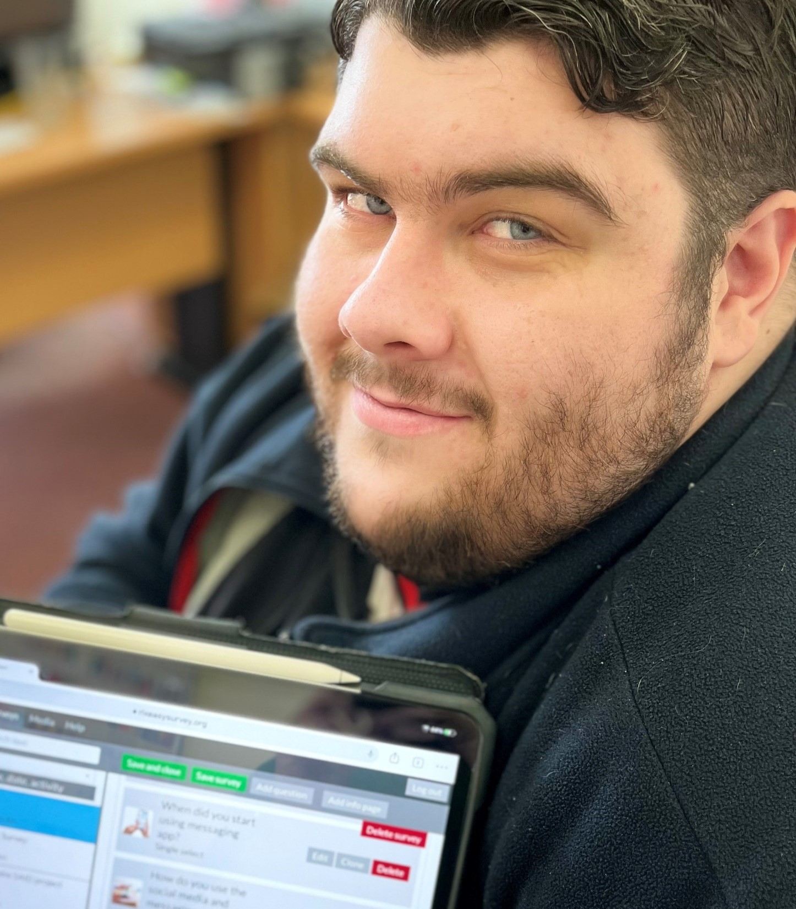
SAID PROJECT
Presenter: Patrick Fitzgerald
Sarah Gavra Boland

Slide 2
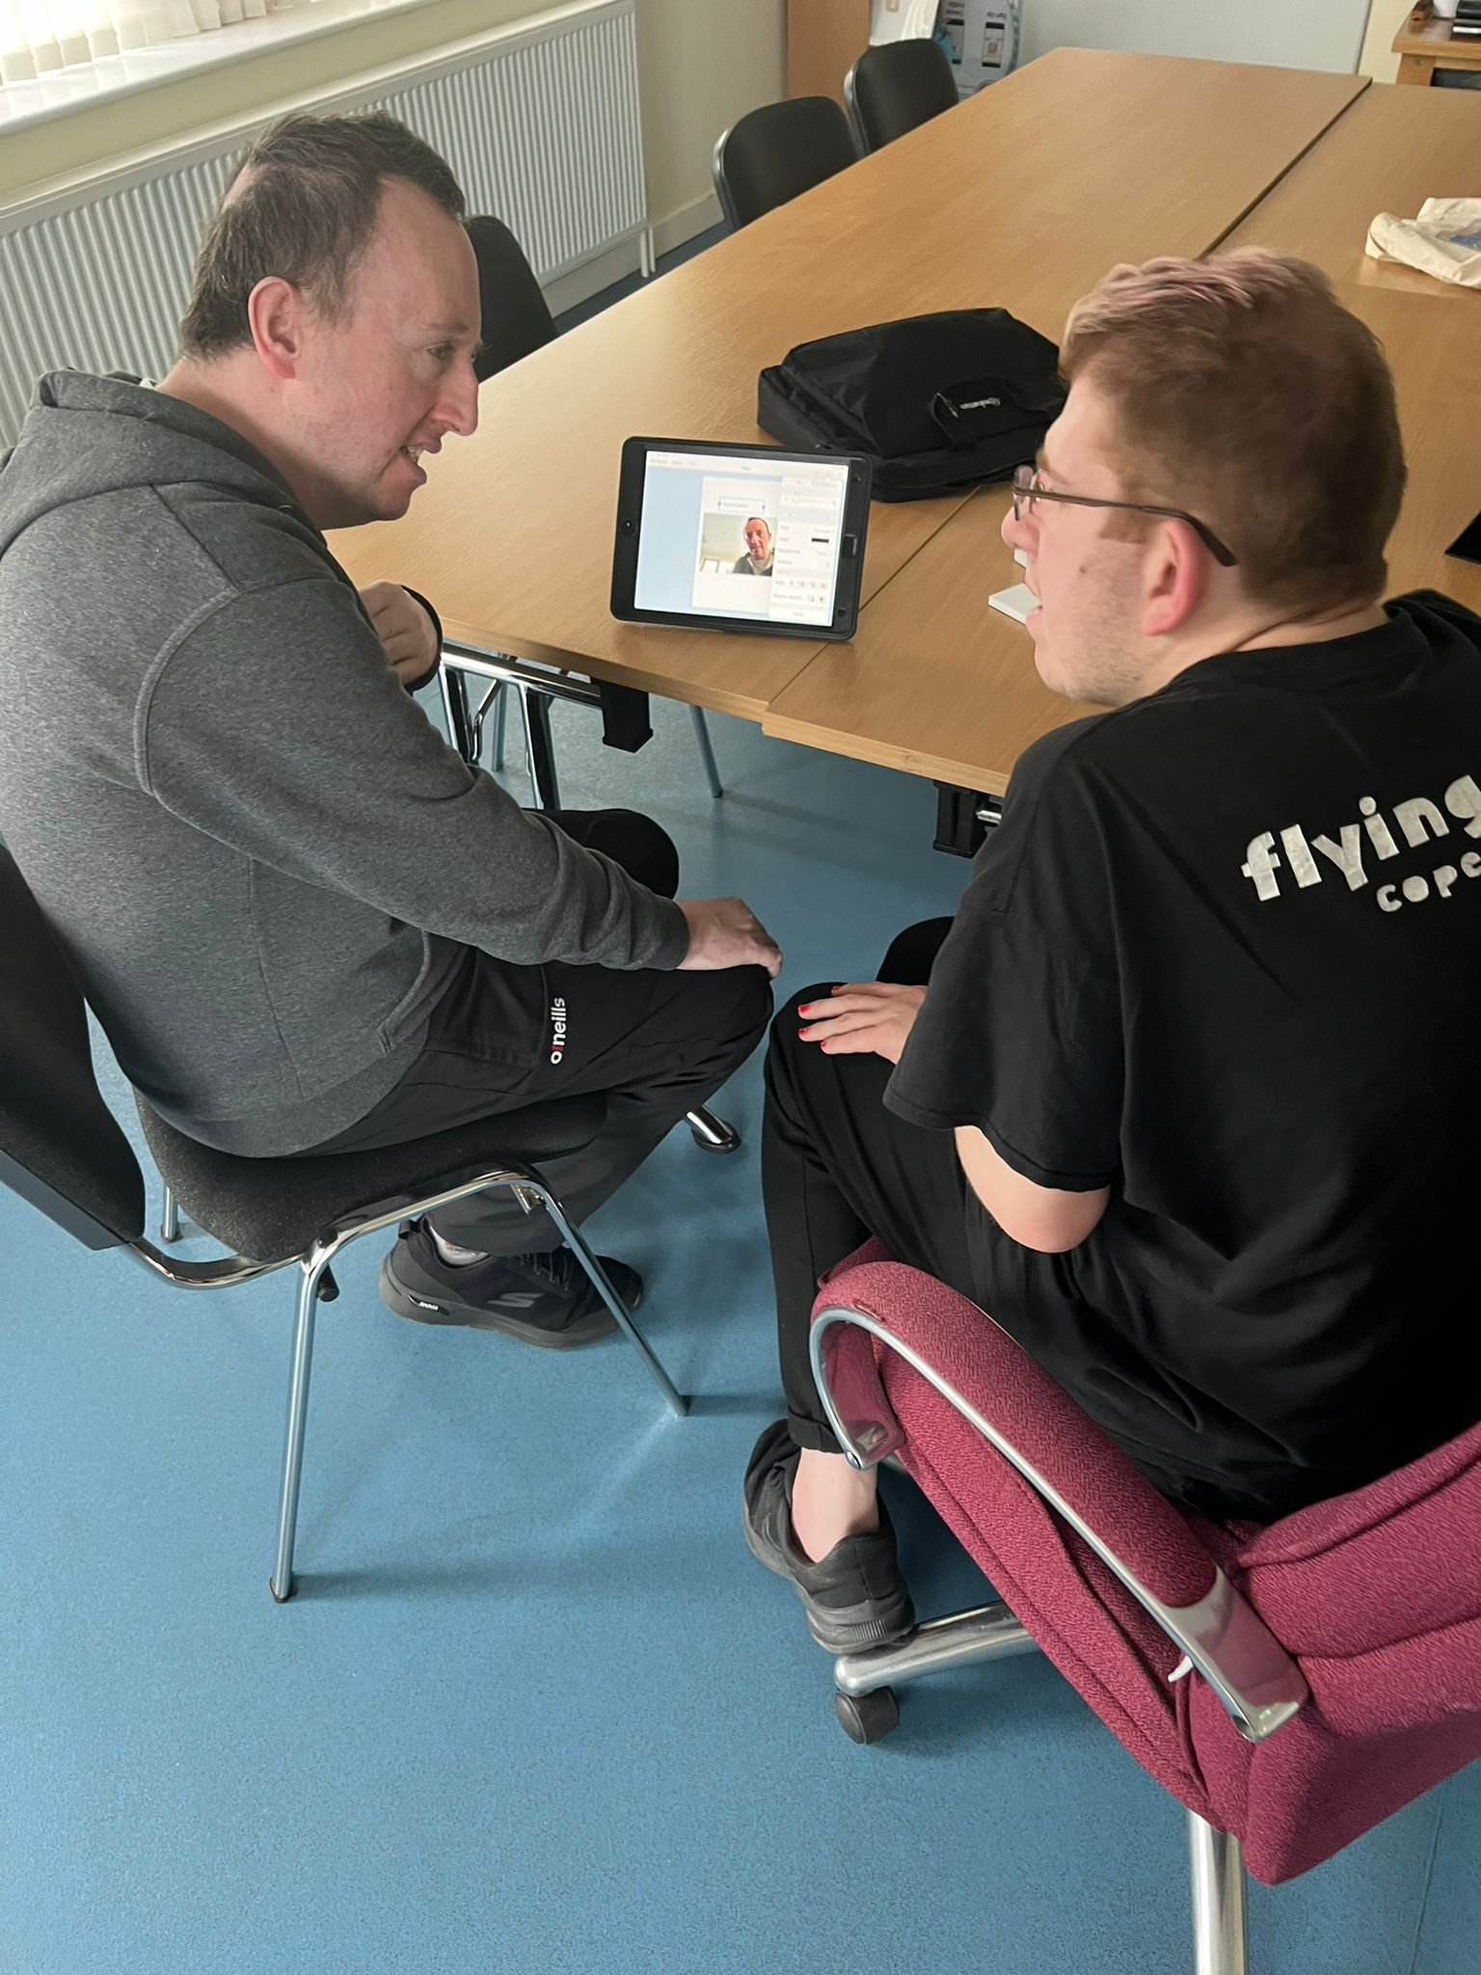
What I will talk about today:
What the SAID project is about.
SAID project in Ireland
Why I want to be a Digi Coach.
What Digi Coaches do
What Digi Coaches need to know
How Digi Coaches are trained
My hopes
Notes:
Using Technology started for us in our Self advocacy meetings with the Liffey Voices in 2014. Assistive and Accessible technology is important for us. It helps us to be able to access information and to create our own information for others to understand our challenges and give us a voice to self advocate.
We started using Little Story Creator and then moved to the Book Creator and then onto Adobe Spark. This changed everything we no longer had to ask Sarah or other staff to type our minutes or write our emails.
We ended up teaching the staff and others, showing them what Text to speech was and Speech to text.

Slide 3
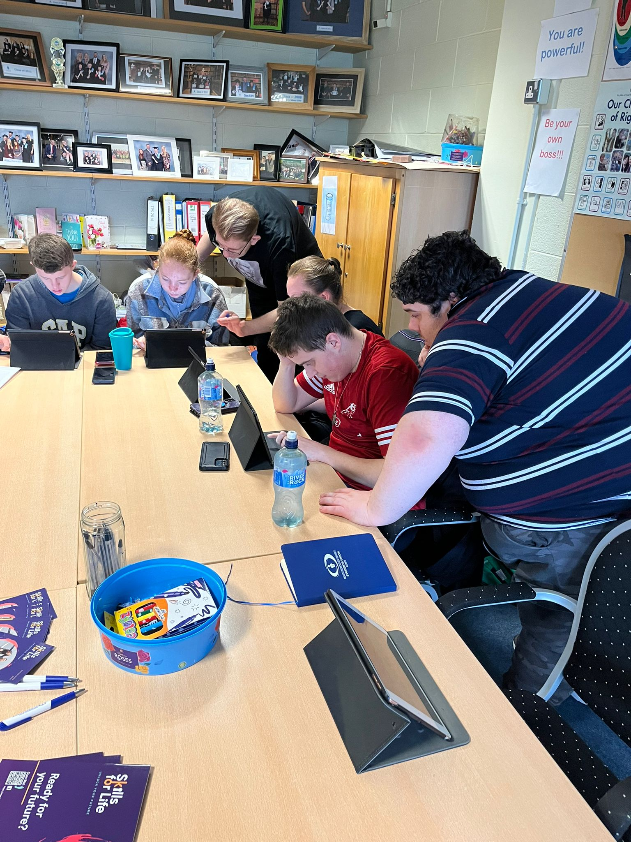
What is the SAID project about?
atempo is the lead of the “School Assistance for Digital Education”.
The project’s goal is to help young people with disabilities to learn digital skills and become trained Digi Coaches.
Digi Coached assist in teaching digital skills to children in grade 1 - 4
Notes:
Using Technology started for us in our Self advocacy meetings with the Liffey Voices in 2014. Assistive and Accessible technology is important for us. It helps us to be able to access information and to create our own information for others to understand our challenges and give us a voice to self advocate.
We started using Little Story Creator and then moved to the Book Creator and then onto Adobe Spark. This changed everything we no longer had to ask Sarah or other staff to type our minutes or write our emails.
We ended up teaching the staff and others, showing them what Text to speech was and Speech to text.

Slide 4
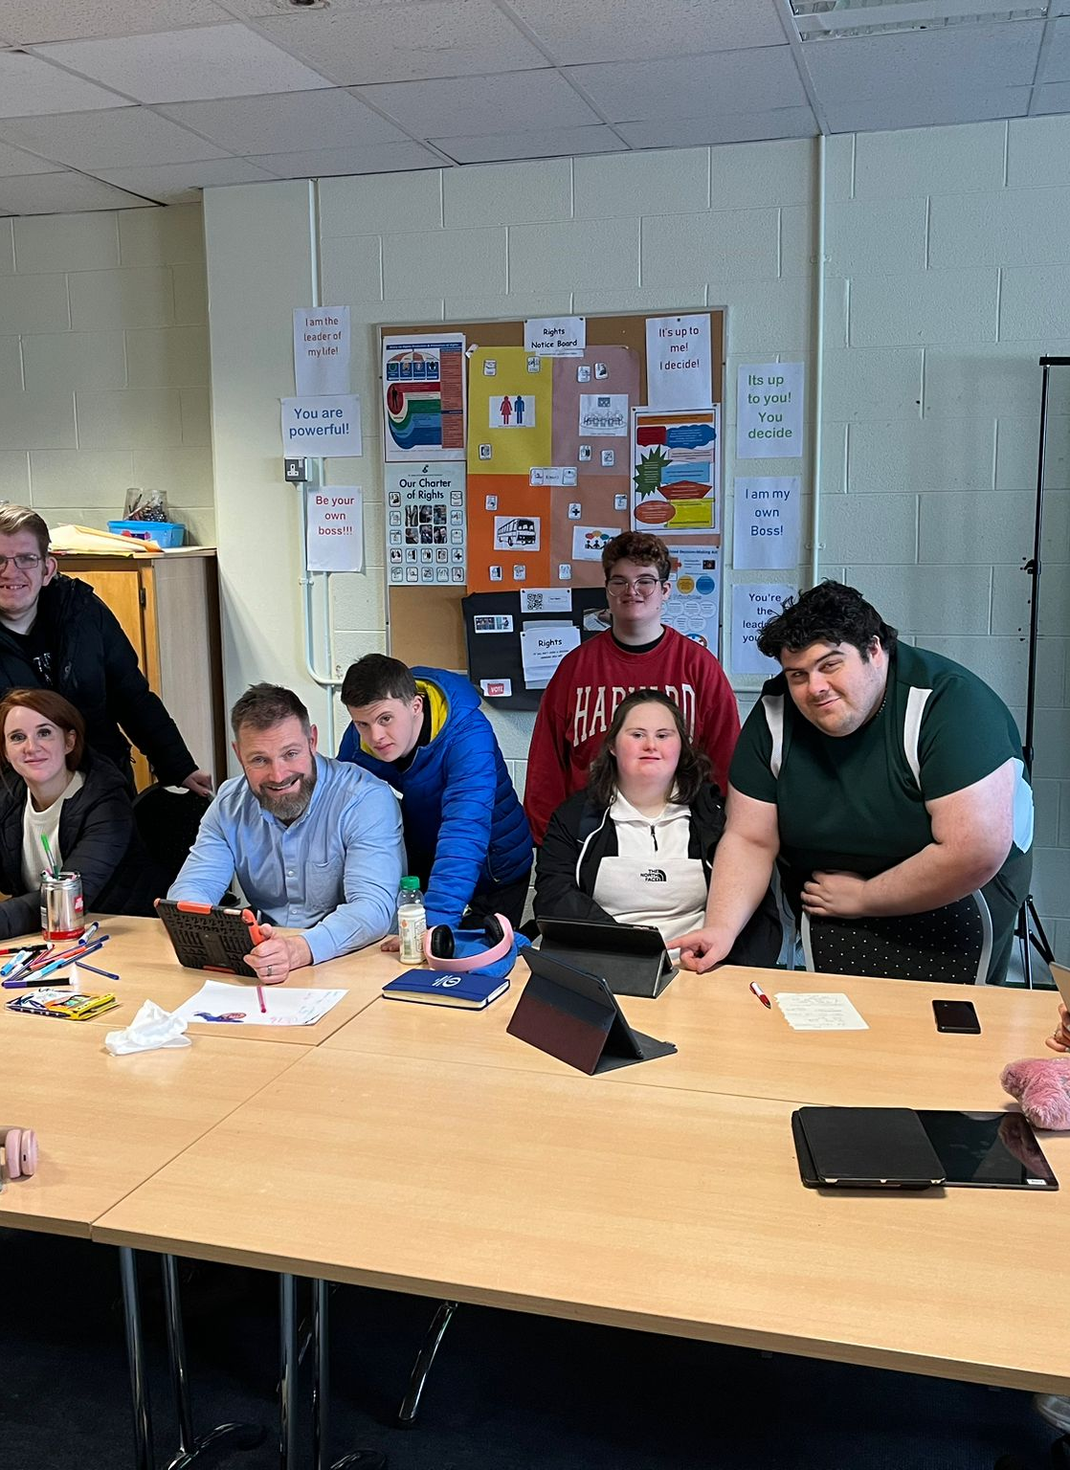
SAID project in Ireland
There are two Digi Coach teams in Ireland. One is run by SJOG in Dublin with 4 Digi Coaches.
The other down in Kerry with 4 Digi Coaches being trained.
Notes:
Using Technology started for us in our Self advocacy meetings with the Liffey Voices in 2014. Assistive and Accessible technology is important for us. It helps us to be able to access information and to create our own information for others to understand our challenges and give us a voice to self advocate.
We started using Little Story Creator and then moved to the Book Creator and then onto Adobe Spark. This changed everything we no longer had to ask Sarah or other staff to type our minutes or write our emails.
We ended up teaching the staff and others, showing them what Text to speech was and Speech to text.

Slide 5
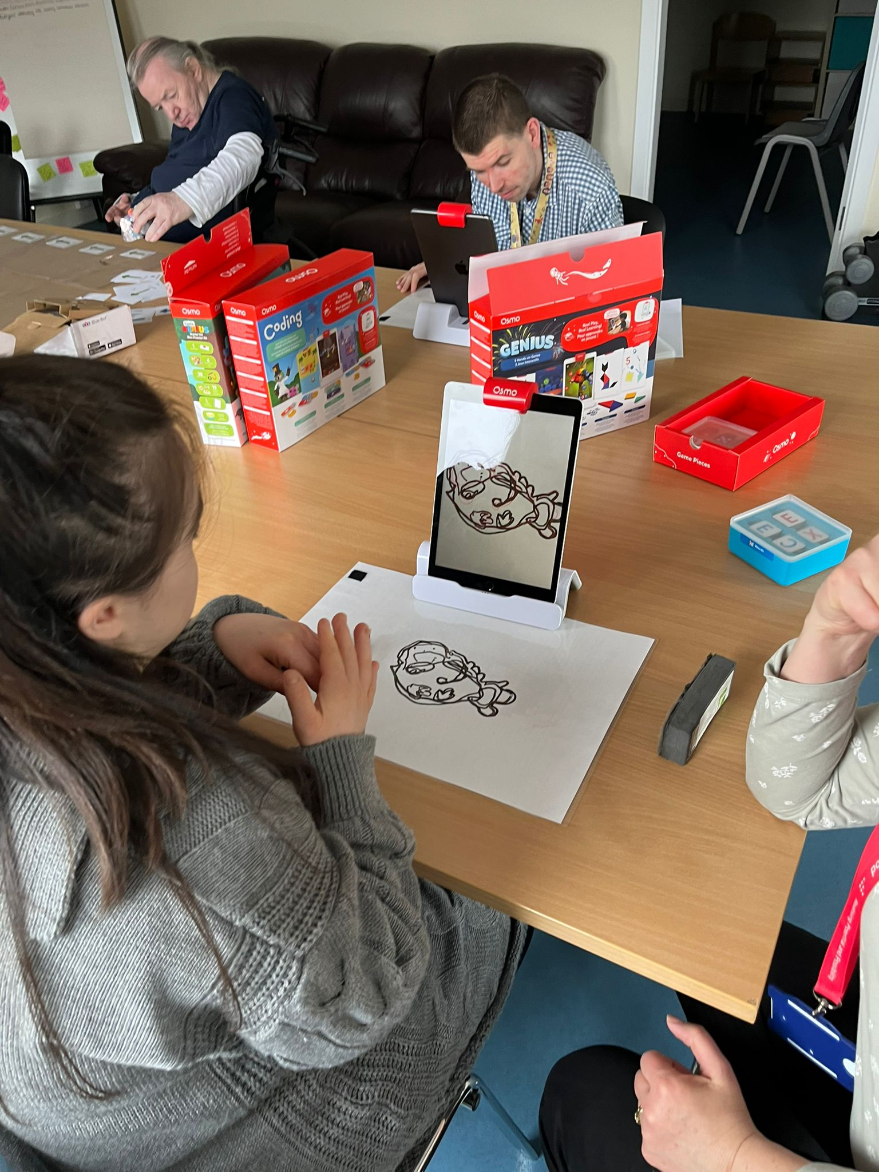
Why is it good to be a Digi Coach?
This project helps young people, like me, to be included in the digital world.
It shows how everyone can be included in digital education.
Children will learn that people with disabilities can be experts too.
I can be proud of my achievements
I can share my skills and knowledge
Notes:
Using Technology started for us in our Self advocacy meetings with the Liffey Voices in 2014. Assistive and Accessible technology is important for us. It helps us to be able to access information and to create our own information for others to understand our challenges and give us a voice to self advocate.
We started using Little Story Creator and then moved to the Book Creator and then onto Adobe Spark. This changed everything we no longer had to ask Sarah or other staff to type our minutes or write our emails.
We ended up teaching the staff and others, showing them what Text to speech was and Speech to text.

Slide 6
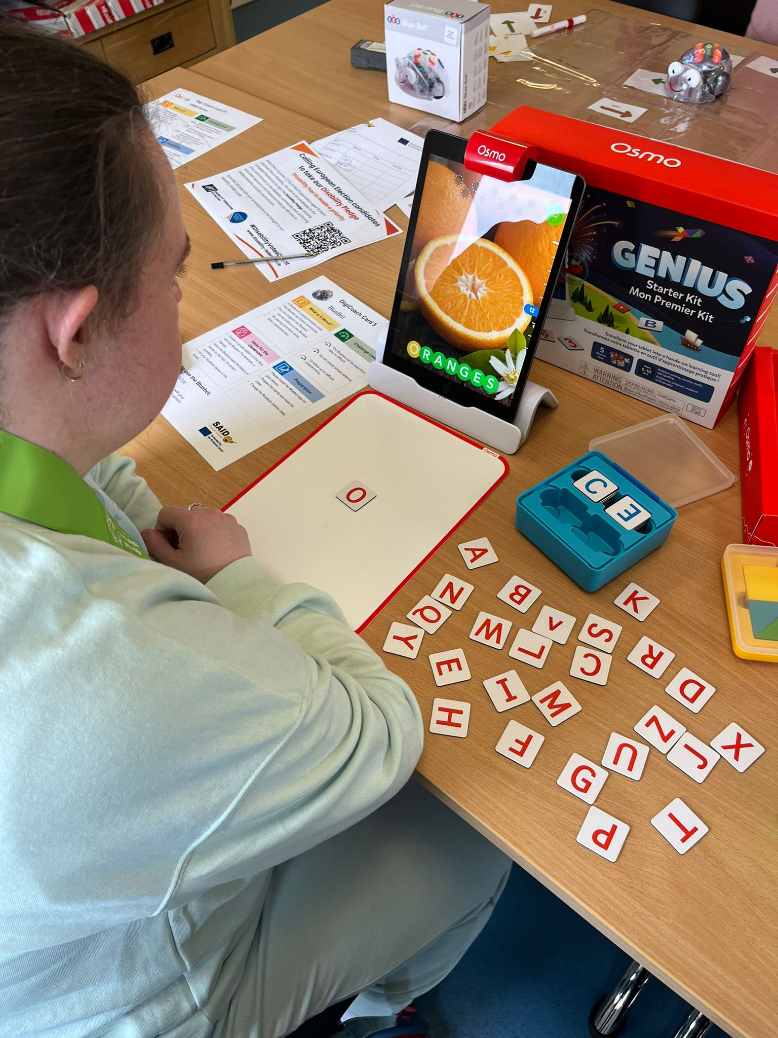
What do we do as Digi Coaches?
Digi Coaches are school assistants.
Digi Coaches support teachers with inclusive digital teaching
We teach children:
digital skills,
how to be safe on the internet
we teach them educational games like: Bits Board,
Osmo coding, Book Creator
Notes:
Using Technology started for us in our Self advocacy meetings with the Liffey Voices in 2014. Assistive and Accessible technology is important for us. It helps us to be able to access information and to create our own information for others to understand our challenges and give us a voice to self advocate.
We started using Little Story Creator and then moved to the Book Creator and then onto Adobe Spark. This changed everything we no longer had to ask Sarah or other staff to type our minutes or write our emails.
We ended up teaching the staff and others, showing them what Text to speech was and Speech to text.

Slide 7
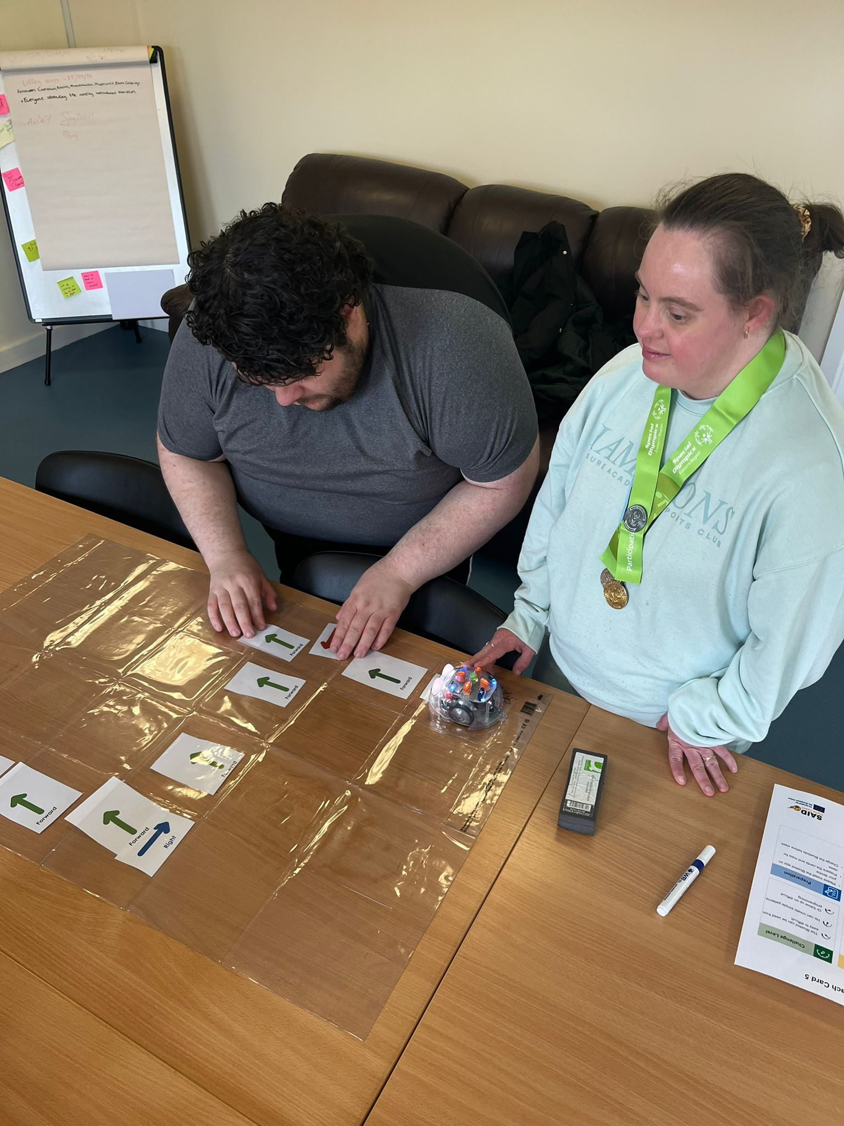
What Digi Coaches learn?
Basic digital skills like browsers, digital devices
How to use the internet and social media safely. Important things like digital stress, secure passwords, fake news
How to share my skills and knowledge.
Notes:
Using Technology started for us in our Self advocacy meetings with the Liffey Voices in 2014. Assistive and Accessible technology is important for us. It helps us to be able to access information and to create our own information for others to understand our challenges and give us a voice to self advocate.
We started using Little Story Creator and then moved to the Book Creator and then onto Adobe Spark. This changed everything we no longer had to ask Sarah or other staff to type our minutes or write our emails.
We ended up teaching the staff and others, showing them what Text to speech was and Speech to text.

Slide 8
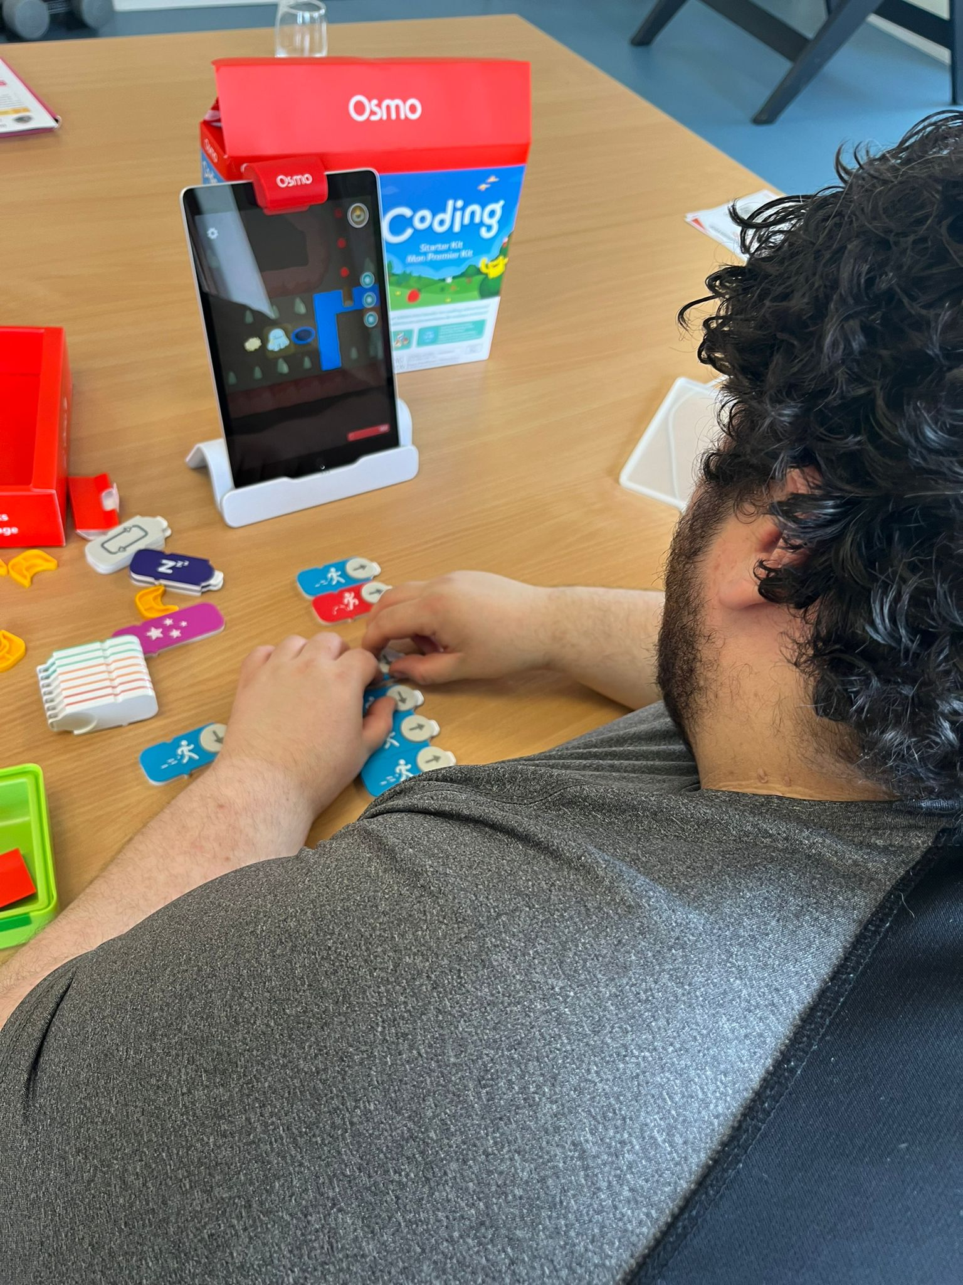
Further Learnings
To use and teach fun games like: Osmo coding, Bits Board, Book creator
I learned to use accessibility tools
Communication skills
I practiced sharing what I know
To be patient
Notes:
Using Technology started for us in our Self advocacy meetings with the Liffey Voices in 2014. Assistive and Accessible technology is important for us. It helps us to be able to access information and to create our own information for others to understand our challenges and give us a voice to self advocate.
We started using Little Story Creator and then moved to the Book Creator and then onto Adobe Spark. This changed everything we no longer had to ask Sarah or other staff to type our minutes or write our emails.
We ended up teaching the staff and others, showing them what Text to speech was and Speech to text.

Slide 9
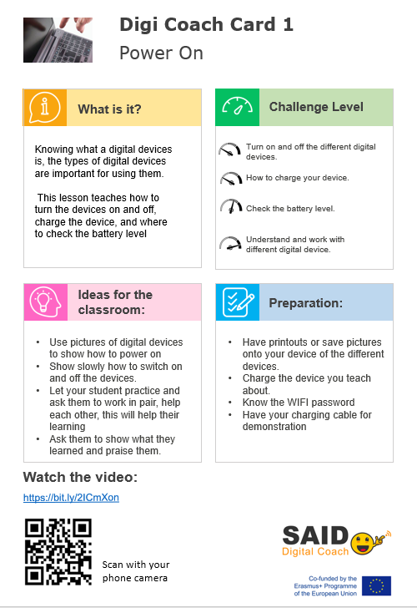
What Digi being trained?
We started with the easiest, the basic skills. We learned step-by-step
We have Digi Coach Cards for all the topics to help us remember
We did role-plays with each other
We went down to Kerry and taught what we learned
We practice by teaching our peers
Notes:
Using Technology started for us in our Self advocacy meetings with the Liffey Voices in 2014. Assistive and Accessible technology is important for us. It helps us to be able to access information and to create our own information for others to understand our challenges and give us a voice to self advocate.
We started using Little Story Creator and then moved to the Book Creator and then onto Adobe Spark. This changed everything we no longer had to ask Sarah or other staff to type our minutes or write our emails.
We ended up teaching the staff and others, showing them what Text to speech was and Speech to text.

Slide 10
My Hopes
Help Others: Teach and support children in learning how to use computers and other digital tools.
Build Confidence: Show that I can be good teacher and a role model.
Gain Skills: Learn more about technology and improve my own skills.
Make Friends: Work with teachers and students, and build new friendships.
Feel Proud: Achieve their goals and feel proud of their work.
Make a Difference: Help others succeed and feel happy about my contribution.
Notes:
Using Technology started for us in our Self advocacy meetings with the Liffey Voices in 2014. Assistive and Accessible technology is important for us. It helps us to be able to access information and to create our own information for others to understand our challenges and give us a voice to self advocate.
We started using Little Story Creator and then moved to the Book Creator and then onto Adobe Spark. This changed everything we no longer had to ask Sarah or other staff to type our minutes or write our emails.
We ended up teaching the staff and others, showing them what Text to speech was and Speech to text.

