Slide 1
Advancing UDL Internationally Together
AHEAD Ireland March 20th 2024
Sam Catherine Johnston
Chief Postsecondary and Workforce Development Officer, CAST

Slide 2
Our accessibility commitments
We have run an accessibility check on the slides and corrected any errors
All images have alt text
All videos have captioning
I will describe all visual information
Close captioning is enabled
Questions can be asked during the Q and A or via follow up

Slide 3
About CAST
CAST leads, inspires, and convenes a global community to design equitable, inclusive learning experiences through our Universal Design for Learning framework.
We envision a world where all learning experiences in school, the workplace, and life are intentionally designed to elevate strengths and eliminate barriers so everyone has the opportunity to grow and thrive.

Slide 4
Honoring AHEAD Ireland work
UDL implemented across the country
Robust professional development in place
Prioritized and planned for sustainability
Scaled cross sectoral collaboration
Human diversity and success for all placed front and center

Slide 5
The power of design
Writing at a portable desk with reed, reed knife, and ink well
Scribes were the guardians of codified knowledge
In the age of ink wells, scribes had to be right handed
Pier-Francesco Sacchi. Les Docteurs de l'Église (Genoa?, 16th c)

Slide 6
From a Mismatch to a Disability
Left is unclean hand, right is hand for eating
“Sinister” comes from left in Latin
“Gauche” in French means left and is a synonym for not right
“two left feet” means someone is clumsy

Slide 7
1888: First Patent Filled for Ballpoint Pen
“My invention consists of an improved reservoir or fountain pen, especially useful, among other purposes, for marking on rough surfaces such as wood, coarse wrapping-paper, and other articles where an ordinary pen could not be used.”
John J LOUD, Tanner
The world was introduced to this modern-day ballpoint pen in 1931 at the Budapest International Fair by László Bíró, a newspaper editor who needed ink to dry faster.

Slide 8
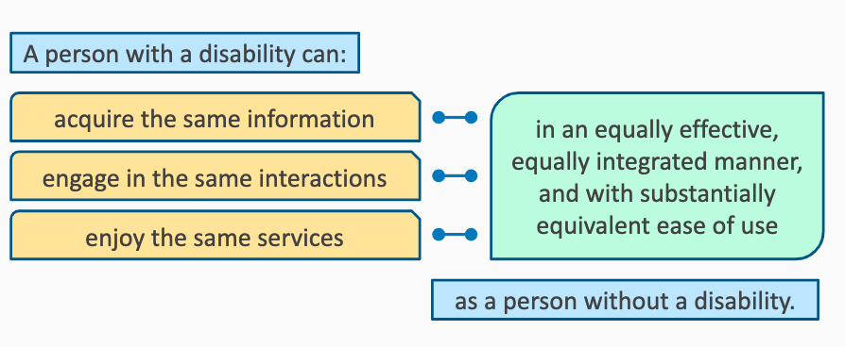
Accessibility as Defined by the U.S. DOE/Office for Civil Rights

Slide 9
European Accessibility Act 2019
Accessibility: design of products, devices, services or environments to be used by people with disabilities on equal basis with others.

Slide 10
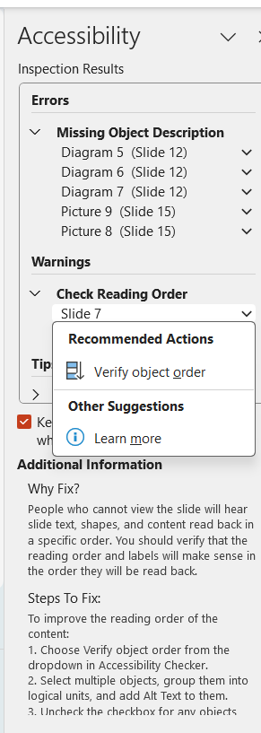
Accessibility goes mainstream
All educators should have a baseline training in accessibility best practices.

Slide 11
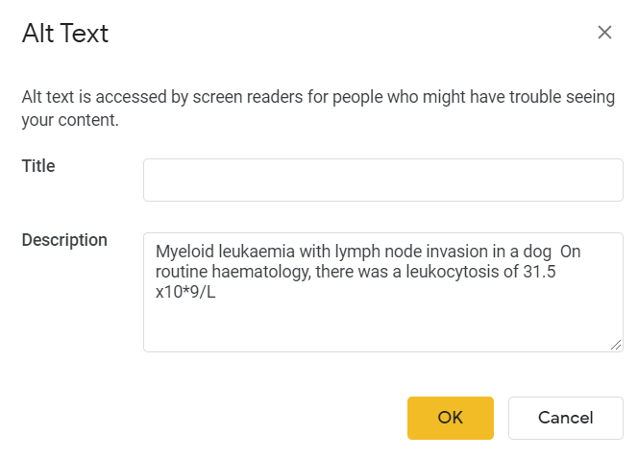
Accessibility to improve learning

Slide 12
Collective action creates large scale change
Accessible procurement policies and practices
Elevate possibilities for personalization through technology
Build capacity to create and use accessible materials
Disability inclusive hiring and create an accessible workplace

Slide 13
Access stretches beyond accessibility
Professor holds baby during 3-hour class after student couldn’t find a sitter (yahoo.com)

Slide 14
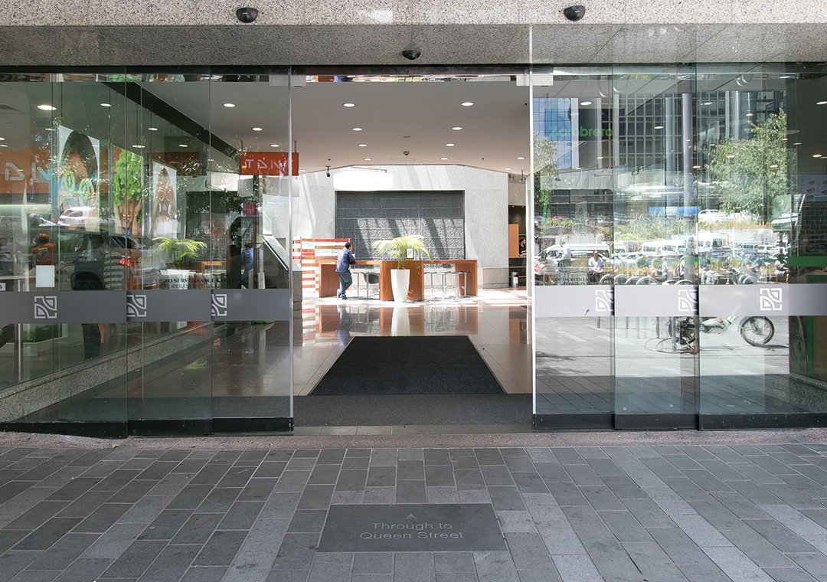
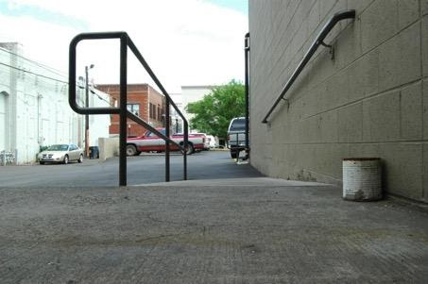
Universal Design vrs. Accessibility as Retrofit

Slide 15
Hospitality
Offering the gift of hospitality is an antidote to estrangement. In his book, Reaching Out, Henri Nouwen defines hospitality as “creating free and friendly space for the stranger”. As such, it is an invitation to relationship. A hospitable relationship provides a welcoming presence and creates a safe refuge from an often impersonal, hostile world. Ken Kraybill

Slide 16
Universal Design and user centered co-design
Universal design for physical and digital infrastructure as the starting point coupled with user centered co-design to build awareness of exclusionary practices and how to replace them.

Slide 17
A different kind of international bank
What should our spaces (e.g., walls, signage, art, homepages, Virtual Reality) look like for equity in expression of identities?
Whose voices haven’t been heard and how do we structure communication and engagement to amplify them?
What should our spaces look like for socially just assessments (Hainsworth and Bracken, site)?

Slide 18
UDL Guidelines 3.0.
UDL Guidelines 3.0 (cast.org)

Slide 19
Reframing Intelligence

Slide 20
Fish scale model
Collective achievement made possible by the overlap of narrow specialties
Social creativity
Cultures of participation
Gerhard Fischer

Slide 21
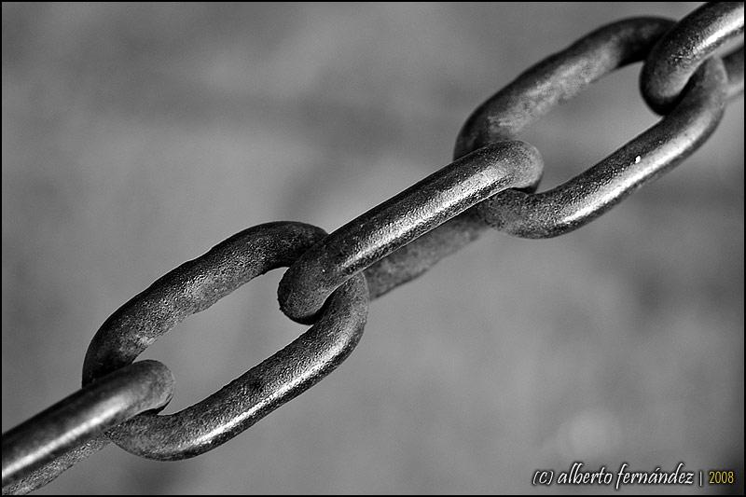
Environment optimized for all learners
Much like strong links in a chain, well-supported students, can reinforce one another’s efficacy expectations, provide a wide variety of models of how to reach learning goals, and support one another to become self-regulated learners.
"Eslabones de mi Cadena || Links of my Chain" by Alberto Fernández is licensed under CC BY-NC-ND 2.0

Slide 22
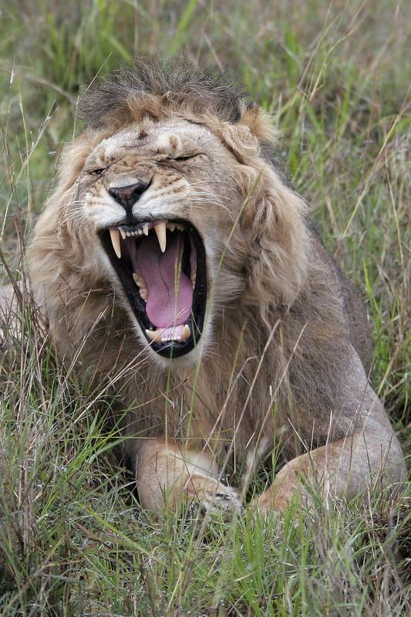
Social to self model of self-regulation
“models, verbal description, and social guidance and feedback” influence self-regulation. As the learner becomes more independent, individual influences take hold, promoting “internal standards, self-reinforcement, self-regulatory processes, self-efficacy beliefs” (p.198)Schunk and Zimmerman, 1997
"Mouth Wide Open - Lion" by TangoPango is licensed under CC BY-NC 2.0

Slide 23
International bank of socially just assessment
Co-design
How can we regularly ask students for feedback on assessments
Choice
What strategies are we using to offer multiple ways to demonstrate and build skills and understanding
Variability
How do assessments celebrate variability in learners and experiences
Connection
How do assessments create the capacity for students to reflect on and talk about their learning

Slide 24
AI and distributed intelligence
How could a new model of intelligence as distributed rather than individual enable us to use Artificial Intelligence differently?
Could we add this to our international bank??

Slide 25
Questions and ideas

Slide 26
Video by Coor Down world down syndrome day

Slide 27
Thank you!
Find out more: workforce.cast.org
Contact us at cast@cast.org
Follow CAST on social media: @CAST_UDL

