Slide 1
AHEAD Strategic Plan 2024-28
Mar 20th 2024

Slide 2
Development Process
Strategic Oversight
Strong Foundations
Deep Stakeholder Engagement
Iterative Design with Staff & Board

Slide 3
Our Mission & Vision
Our Mission
AHEAD works with and for disabled people to shape inclusive and empowering environments in tertiary education and employment.
Our Vision
An equitable society where people with disabilities have the power and opportunity to flourish through education and employment.

Slide 4
Our Values

Slide 5
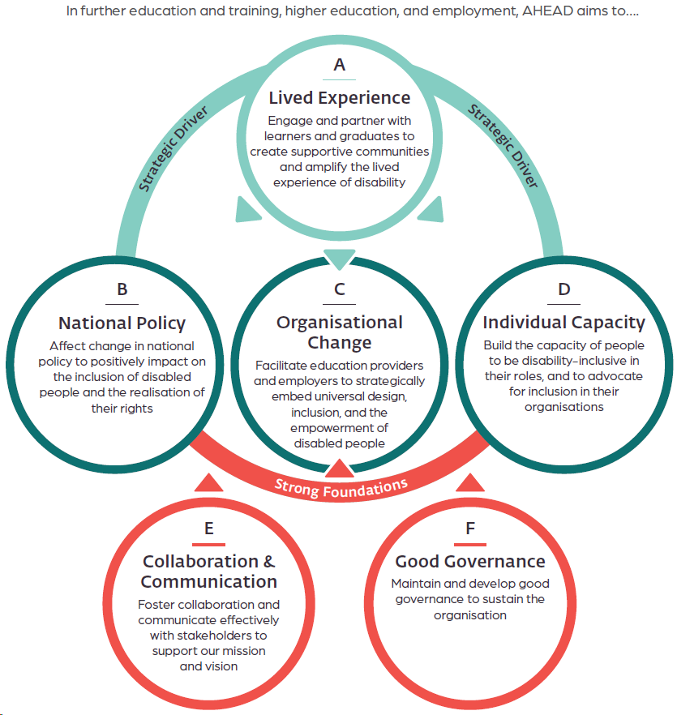
Strategic Objectives

Slide 6
Thank you to all who contributed to the development of this plan!

