Slide 1
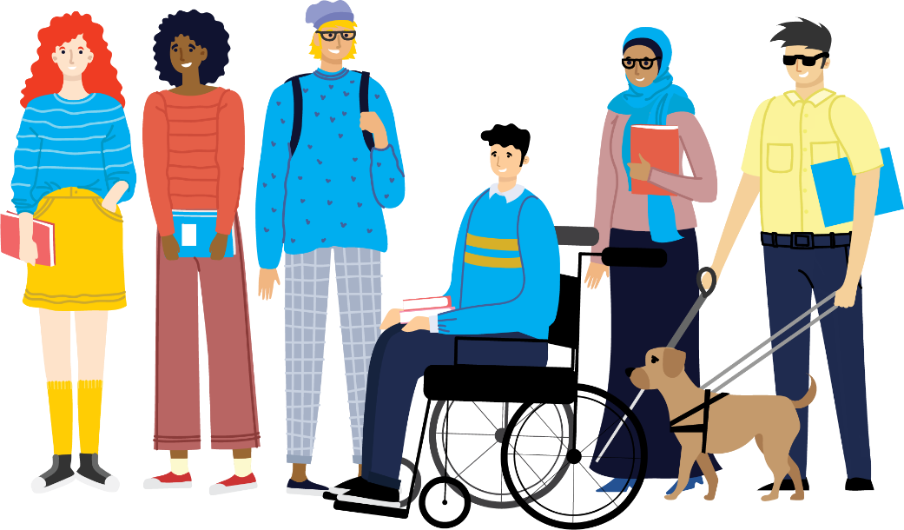
Laying the Foundations: how accessibility supports AT use
Danielle O’Rourke, AHEAD GATHER 2024
Notes:
While this is an Assistive Technology event, it would be remiss of me not to mention some basic Accessibility measure. Without these, some assistive technology won’t work, or will be more difficult for AT users to access. Recently we had Global Accessibility Awareness Week, which led to a bunch of really good resources coming out from lots of different sectors of society.

Slide 2
In this session
What is accessibility?
Why should we talk about it?
Basics and Examples
Headings, formatting, and text
Images
Links
Design
Models for accessible content

Slide 3
What do we mean when we say “accessibility”?
Put in the chat what comes to mind for you
Notes:
Accessibility is a term that’s used for a number of different things – for example, a lot of people might use it in the context of “making a product accessible to customers by reducing the price” – it’s literally more accessible for more people. However, in my work, I use it in the context of “this content can literally be accessed by disabled people”. That will come with its own metrics and standards, and you’ll often find that some accessibility guides offer conflicting information – this is because not all disabled people are the same! Some may have conflicting access needs and that’s okay! One major element of accessibility is ensuring that people have autonomy in how they get your information, because one size never fits all!

Slide 4
Accessibility and Assistive Technology
Notes:
But Danielle, this is an Assistive Tech event – why are you focusing on content and structure instead of this cool piece of software/hardware I wanna use? Well, while I’d love to be showing you some cool flashy tech, you’ll be seeing that from a lot of our other presenters, and I think that getting the foundations right allows us to build securely from there. What I mean is this: you can have the most advanced, expensive, innovative new tech on the market, but if the content you’re trying to get isn’t accessible, that tech isn’t going to help much.

Slide 5
UCSF Example Video
Notes:
I use the text to speech function on my phone a lot, particularly for reading longer pieces of text. However, if my phone cannot parse that text or content on the screen, then what I’ll hear is not much use to me.
Take this for example. This is a video from UCSF in the States to demonstrate how an inaccessible document will still be inaccessible to a screen reader.

Slide 6
So…now what?
Notes:
So now you know the what of digital accessibility, and the General Why, I’ll move into some specific tips. I don’t know about you, but I always find it helpful to know WHY I’m doing something – I was that annoying child who pestered my parents with Why Why Why. So, For each tip, I’m going to approach it with the “Toddler Method” – explaining WHY at every step!

Slide 7
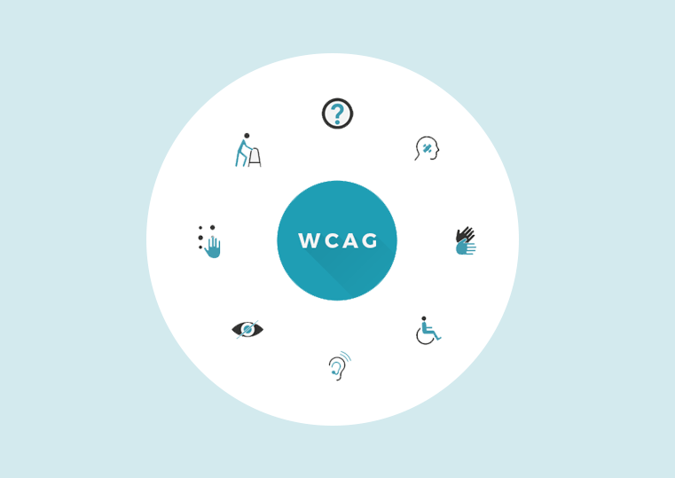
Web Content Accessibility Guidelines (WCAG)
50 relevant standards:
objective
measurable
quickly demonstrated
robust
Notes:
Danielle
There is also another Big Why in the background here, which is the law/regulations governing public bodies/institutions, including the Web Content Accessibility Guidelines. These are a set of standards that guide web content creators, developers, etc on how tot make their information accessible.
WCAG forms the main bulk of web accessibility standards. They outline the concepts behind the standard, the reason why it’s important, how to incorporate it, ideas/suggestions, and what counts/doesn’t counts, i.e, successful uses and unsuccessful uses.
Don’t need to know all of them, but it is good reference point!

Slide 8
Headings, formatting and text
Heading 1
Heading 2
Heading 3
Bullet point number 1
My second point
And thirdly
First numbered list item
Secondly
thirdly
Notes:
As we seen in the UCSF video, headings helped the screen reader technology to identify where the important content is, and also in what order to read it, ie, Heading 1 comes before Heading 2, etc. Headings also let you style text easily, so you’re not manually changing the font, the size, or colour for each heading in your document or presentation.
It’s also helpful for those who find taking in information more difficult, as they can scan the screen to identify key points/structures.
Text formatting doesn’t stop at headings though – take a numbered list for example. Instead of manually typing “1., 2., 3.” for your items, and spacing them how you like, it’s much easier and more accessible when you use the built-in function for that, whether it be in word/google sheets/etc. This doesn’t just save you time – it also puts a html tag in the background, indicating to Assistive Technology users that this is a list with X number of items. Otherwise, they won’t know how long the list is, and it may go on forever!

Slide 9
Images and Alt Text
Functional Images (e.g., image used as a clickable item to go to another website or download something)
Images of text (ideally avoid, otherwise replicate text into alt text)
Complex images (graphs, diagrams)
Groups of images (to convey a single piece of information, or not)
Image maps (hotspot area interaction)
Alt text: hand reading braille
Notes:
Again going back to that UCSF video, using alternative text for non-text conent (e.g. images) is so important. However, not all images are made equal! Some on this slide set for example – a lot of images or non0text content we use is used for the purpose of visually distinguishing items, or giving a visual flair to the look of a document or slide. While this content is visually pleasing, it doesn’t offer any information to the audience. For these images, we “mark them as decorative” or use an empty alt tag, ie, the screenreader won’t read out “squiggly black line” every time!
If your image conveys something to the audience, e.g., it’s an example of something you’re talking about, it shows a certain person relevant to the content, or it has any information in it that can be seen visually, you should put that in the alt text.
There’s a great “Decision tree” created by the W3C group (group that publish the WCAG guidelines): https://www.w3.org/WAI/tutorials/images/decision-tree/
Functional images: The text alternative of an image used as a link or as a button should describe the functionality of the link or button rather than the visual image. Examples of such images are a printer icon to represent the print function or a button to submit a form.
Images of text: Readable text is sometimes presented within an image. If the image is not a logo, avoid text in images. However, if images of text are used, the text alternative should contain the same words as in the image.
Complex images such as graphs and diagrams: To convey data or detailed information, provide a complete text equivalent of the data or information provided in the image as the text alternative.
Groups of images: If multiple images convey a single piece of information, the text alternative for one image should convey the information for the entire group.
Image maps: The text alternative for an image that contains multiple clickable areas should provide an overall context for the set of links. Also, each individually clickable area should have alternative text that describes the purpose or destination of the link.

Slide 10
W3C Alt Text Decision tree
Does the image contain text?
Yes:
… and the text is also present as real text nearby = use an empty alt attribute.
… and the text is only shown for visual effects = use an empty alt attribute.
… and the text has a specific function, for example is an icon = use the alt attribute to communicate the function of the image.
… and the text in the image is not present otherwise = use the alt attribute to include the text of the image.
View the full W3C Decision Tree on their website

Slide 11
Links
Watch Disney’s 1951 Alice in Wonderland movie on Disney+ (opens in new tab)
Notes:
I’ve used the still from Disney’s Alice in Wonderland movie here to illustrate my point. Alice is looking at a bunch of signs pointing every which way, all with confusing words such as “this way” or “yonder”. She doesn’t know where each sign is guiding her to – is it the White Rabbit’s tea party? Is it the Queen of Hearts dungeon? Without proper signage, she’s lost.
This is similar to the experience of an internet user trying to navigate links. Particularly when using a screenreader or any summary tools, it’ll give you the links out of context. So a lot of time, you’ll be presented with a bunch of linksw that all just say “click here” or “here” or “this page”. Not helpful! Even though it may make sense to us to put links in text like that, we have to be aware that not all users will be presented with our links in that context. Plus, even people who can visually see the link in the context of the surrounding text should know what’s going to happen once they click that link!
Putting the webpage/document title, the website organisation source, and marking whether the link opens in a new tab or not are great ways to help situate your users.
“naked” links are also no fun – try sitting and listening to a screenreader read out a long string of unintelligible numbers every time you pass a link in text – not fun!

Slide 12
Design
Notes:
Finally we come to my favourite part of content creation – design! While I love a good play around on Canva or Adobe, not all of their templates or suggestions are accessible.
Some things to focus on:
Sans serif fonts
Colour contrast
Busy layouts

Slide 13
…overwhelmed yet?

Slide 14
Accessibility isn’t a chore!
Accessibility checkers built into most software these days
Clear checklists to run through
It’s a Journey!
Notes:
Dara/Danielle
It has never been easier to make your content accessible, or to access content. There are accessibility checkers and reports built-into most software and programmes. There’s AT built-in too.
Online: clear checklists available for content creators (THRIVES).
Nothing will ever be 100% accessible for 100% of people – differing access needs arise. However, like the UDL pyramid, the aim is to make things as universally accessible as possible, while still allowing for those situations where specific and tailored response is needed.

Slide 15
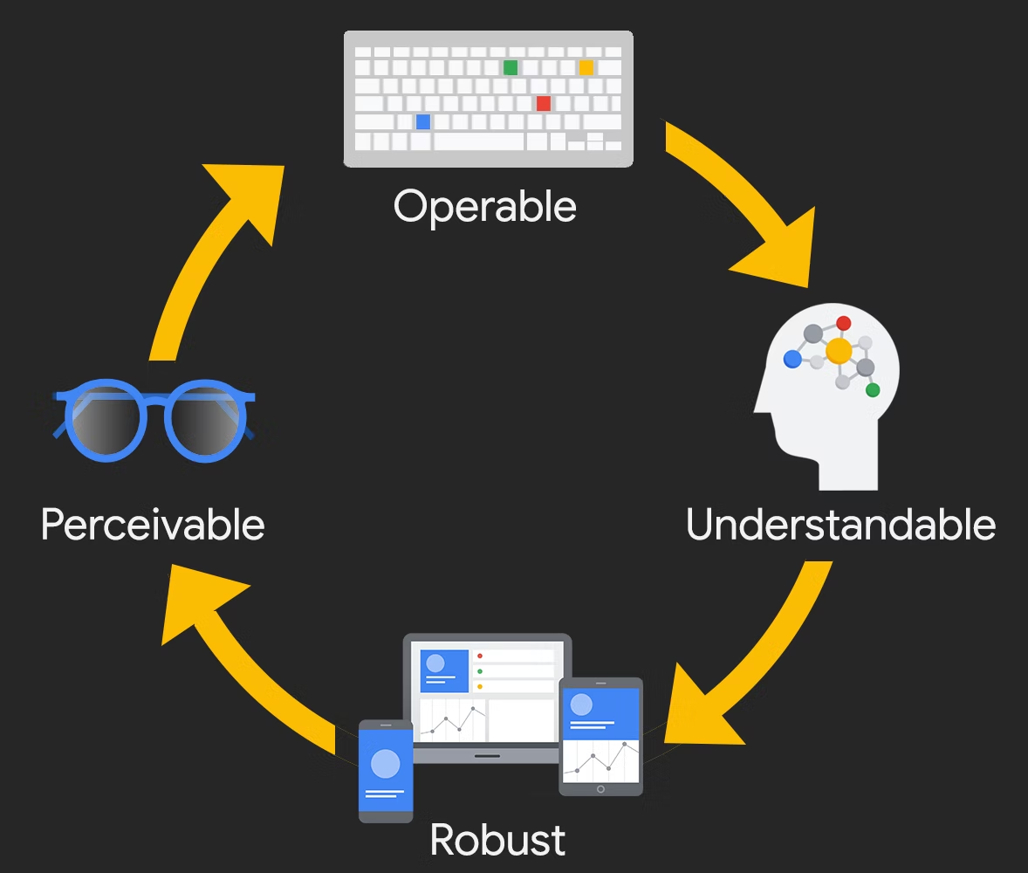
What is Digital Accessibility P-O-U-R
Notes:
Danielle
Basic outline: Perceivable (ie, can they access the information, is it legible), Operable (keyboard, speech control), Understandable (Plain English, predictable), Robust (multiple platforms, secure)

Slide 16
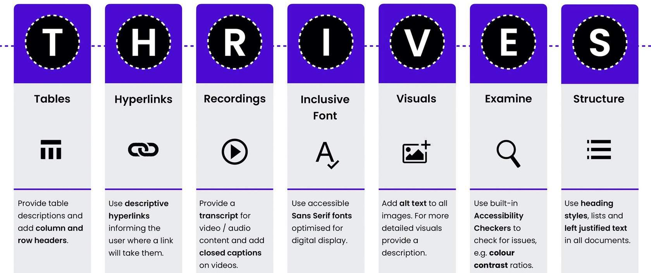
Digital Accessibility – Author Perspective
Resource by Jen McParland, Tracy Galvin
Notes:
Dara

Slide 17
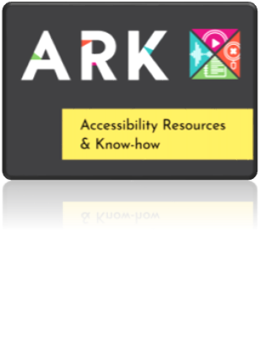
Digital Accessibility: Utilise AHEAD ARK
ARK contains free short courses on:
An Introduction to Digital Accessibility for Educators.
Digital accessibility - a Whole Institution Approach.
Developing a Web Accessibility Statement
Notes:
Danielle
https://www.ahead.ie/ARK

Slide 18
Thank you!
Questions?

