Slide 1
My Voice – My Choice
A Case Study of a collaborative project using UDL Approach
for Adult Learners that attend HSE Day Services in Waterford for people that have an Intellectual Disability
Rosalind Threadgold Access & Inclusion Officer WWETB

Slide 2
Are there options for levels 2 -3 learners

Slide 3
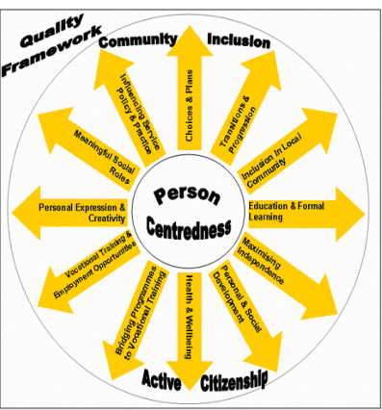
New Directions Policy Guidelines & Interium Standards
.

Slide 4
Adult Safeguarding Policies
To protect vulnerable adults against all types of abuse; physical, sexual, emotional and neglect
Some of the principles underpinning the policy guidelines include:
Respect for human rights
A person centred approached to care and services
Promotion of advocacy.
Respect for confidentially
Empowerment of individuals
A collaborative approach.

Slide 5
Assisted Decision Making Capacity Act 2015
Is about supporting decision-making and maximising a person’s capacity to make decisions.
This new Act assists in complying with human-rights obligations contained in the Constitution of Ireland, the European Convention on Human Rights, and the United Nations Convention on the Rights of Persons with Disabilities.

Slide 6
My Voice – My Choice UDL Course
Support and Accreditation for Self Advocacy and Decision Making
Create Targeted Program & Access Routes
Create pathways from targeted programs
Support day services through collaboration (ALL funding)
Utilise the capacity built in staff in FET and learning from targeted programs.
Design a course for day services through UDL
Give equality of Access to learners with Intellectual Disability
Develop a Checklist for policies and guidelines

Slide 7
Collaborative Process
WWETB
SETU
SOLAS ALL Funding
Inclusion Ireland
Waterford Day Services x 3
Access & Inclusion Officer
AEO for Language, Literacy & Access
Tutors
Learners

Slide 9
Checklist for FET/HEA or Tertiary Education
Course Options – Learner Voice & Choice
Adult Safeguarding Policy
Person Centred Planning – Individualised -Person Centred Plan
Assessment of Need
Physical Environment (Check Access walk through with learners)
Consultation with Stakeholders – Advocacy Agencies/ Services/PWD
Learner Voice built in and throughout – Content relating to their lives
UDL Teaching, Learning and Assessment- Altitude Charter
Assistive Technology
Easy to Read resources & Plain English

Slide 10
Reference Page/ Further Information
New Directions Policy
New Directions Interim Standards
Adult Safeguarding
Assisted Decision Making Capacity Act, 2015
The Disability Act, 2005
The National Advocacy Service for People with a Disability
The IHREC Public Sector Duty
Sustainable Development Goals
The Decision Support Service

