Slide 1
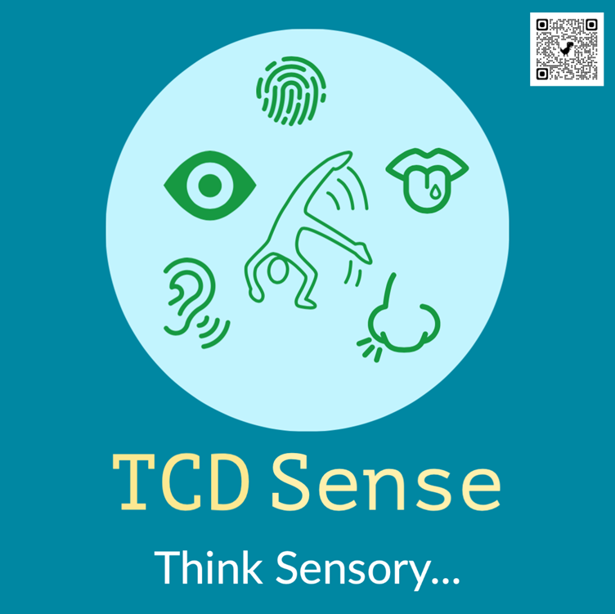
TCD Sense
Dr Kieran Lewis, Occupational Therapy Manager, Trinity Disability Service, TCD Sense Project Lead
Faolan Doecke Launders, TCD Sense Project Intern
20/03/24

Slide 2
Outline
Background
Research
Project Description
Resources
Discussion
Notes:
TCD Sense is an example of identifying an issue t
Student Engagement through Occupational Therapy Support & Disability Service
2018 & 2019: Library UX Study & Library Survey
Feb 2019: Sensory Audit Process carried out in Trinity Libraries and Science Laboratories
May 2019: Survey of Disabled Trinity Students based upon Dunn’s Sensory Processing Framework
January 2020: Working group was established between the Disability Service, Discipline of Occupational Therapy, as well as other stakeholders such as the Trinity Library, TCD SU, and the Science Faculty.
May 2020: Funding Proposal Submitted to the Higher Education Authority as a Strategic Initiative relating to Disability Services in Higher Education Institutions - €233,934 was allocated by the HEA to the project.
May 2021: Additional funding for the Sensory Project was sourced from the Disability Service Budget & Director of Student Services, & TCD SU Budget for Student Spaces.
January 2021 – Present: Activities within the project were planned across four interconnected strands.
hrough engagement with students, understanding it through research, and addressing it through co-production, innovation and partnership.

Slide 3
Introduction
Notes:
TCD Sense is an example of identifying an issue t
Student Engagement through Occupational Therapy Support & Disability Service
2018 & 2019: Library UX Study & Library Survey
Feb 2019: Sensory Audit Process carried out in Trinity Libraries and Science Laboratories
May 2019: Survey of Disabled Trinity Students based upon Dunn’s Sensory Processing Framework
January 2020: Working group was established between the Disability Service, Discipline of Occupational Therapy, as well as other stakeholders such as the Trinity Library, TCD SU, and the Science Faculty.
May 2020: Funding Proposal Submitted to the Higher Education Authority as a Strategic Initiative relating to Disability Services in Higher Education Institutions - €233,934 was allocated by the HEA to the project.
May 2021: Additional funding for the Sensory Project was sourced from the Disability Service Budget & Director of Student Services, & TCD SU Budget for Student Spaces.
January 2021 – Present: Activities within the project were planned across four interconnected strands.
hrough engagement with students, understanding it through research, and addressing it through co-production, innovation and partnership.

Slide 4
Quote from Winnie Dunn
“The experience of being human is embedded in the sensory events of everyday life. When we observe how people live their lives, we discover that they characterize their experiences from a sensory point of view”
(Winnie Dunn, 2001, pp 608-609)​

Slide 5
Why is this important?
Consistent reports from students of difficulty in managing the sensory environment of Trinity
Increasing numbers of neurodivergent students connecting with student services
College can be an overwhelming environment

Slide 6
What is Sensory Processing?
Sensory processing is the means by which individuals obtain information about the world and their own bodies (Brown, Steffen-Sanchez, Nicholson, 2019) ​​
Each of us has an individualised pattern of sensory processing (Dunn, 2007)​
For some individuals, sensory stimuli have a much more significant influence on their perception than others, making for a notably different experience of the world compared to other people whose perception is not as influenced by sensory stimuli.​
We all have different sensory needs that can change depending on neurotype, energy levels, mood, context, and mechanism of perception.

Slide 7
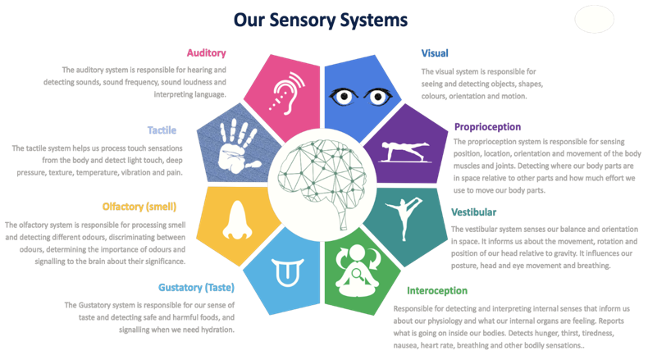
Image - Jessica K Doyle, 2021

Slide 8
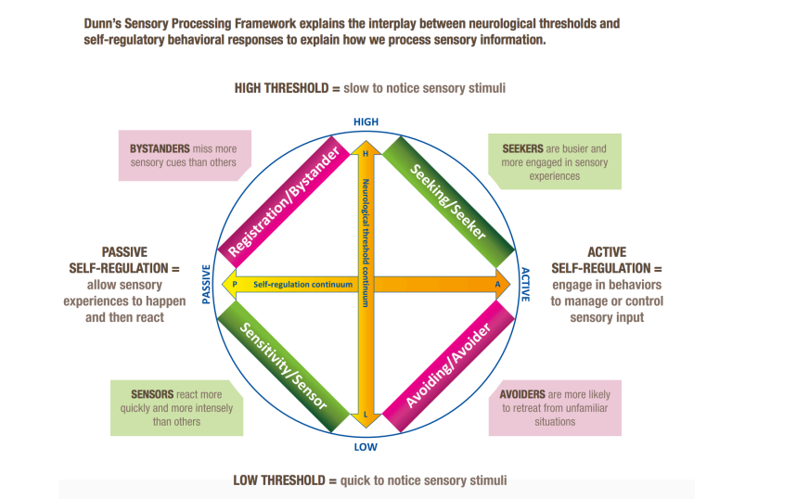
Dunn’s Sensory Processing Framework (Dunn, 2014)

Slide 9
Research
Notes:
TCD Sense is an example of identifying an issue t
Student Engagement through Occupational Therapy Support & Disability Service
2018 & 2019: Library UX Study & Library Survey
Feb 2019: Sensory Audit Process carried out in Trinity Libraries and Science Laboratories
May 2019: Survey of Disabled Trinity Students based upon Dunn’s Sensory Processing Framework
January 2020: Working group was established between the Disability Service, Discipline of Occupational Therapy, as well as other stakeholders such as the Trinity Library, TCD SU, and the Science Faculty.
May 2020: Funding Proposal Submitted to the Higher Education Authority as a Strategic Initiative relating to Disability Services in Higher Education Institutions - €233,934 was allocated by the HEA to the project.
May 2021: Additional funding for the Sensory Project was sourced from the Disability Service Budget & Director of Student Services, & TCD SU Budget for Student Spaces.
January 2021 – Present: Activities within the project were planned across four interconnected strands.
hrough engagement with students, understanding it through research, and addressing it through co-production, innovation and partnership.

Slide 10
Research
Sensory environment of college can be a barrier to engaging in learning, socialising and activities of daily living and an overwhelming place to be (Johnson and Irving, 2008)
Gearhart and Bodie (2012) identified that sensory processing sensitivity was related to college stress
Students can experience a range of issues in managing the sensory environments of college and this can make it difficult to engage in the academic and social elements of college life (Clince, Connolly & Nolan, 2016).
Thompson et al. (2019) maintain that Autistic students are likely to encounter many sensory challenges including loud or crowded environments and may require assistance in managing these effectively.
Notes:
May 2019: Survey of Disabled Trinity Students
68% reported that there is no quiet space on campus that they can access easily if feeling overwhelmed.
Over 50% commented that they go home/leave campus if feeling overwhelmed.
93% would use a quiet space if it was available in the library.
49% reported difficulty with acoustics (e.g. noises, echoes, humming) in the library.
41% reported difficulty with acoustics in lectures.
2018 & 2019: Library UX Study & Library Survey & Sensory Audit
Highlighted issues with wayfinding, lighting, noise, privacy, escape, heating and a lack of people to help

Slide 11
Nolan, C., Doyle, J.K., Lewis, K., & Treanor, D. (2023). Disabled Students’ perception of the sensory aspects of the learning and social environments within one Higher Education Institution.
Notes:
May 2019: Survey of Disabled Trinity Students
68% reported that there is no quiet space on campus that they can access easily if feeling overwhelmed.
Over 50% commented that they go home/leave campus if feeling overwhelmed.
93% would use a quiet space if it was available in the library.
49% reported difficulty with acoustics (e.g. noises, echoes, humming) in the library.
41% reported difficulty with acoustics in lectures.
2018 & 2019: Library UX Study & Library Survey & Sensory Audit
Highlighted issues with wayfinding, lighting, noise, privacy, escape, heating and a lack of people to help

Slide 12
Theme 1: Barriers in the Environment
1.1 - so much going on in the library at all times, that I physically cannot study there, I find it very distracting and lose my concentration, 50% of students describing signage as poor and having difficulty wayfinding around the libraries
1.2 - lighting is too bright, People talking during lectures, desks in learning spaces including lecture halls and libraries to be too close together
1.3 - competing noises and poor acoustics in exams
1.4 - Stuffy air makes me sleepy, Some rooms are so stuffy with no windows it can be hard to concentrate, Over 55% (n=82) of the respondents maintained that poor ventilation
Notes:
May 2019: Survey of Disabled Trinity Students
68% reported that there is no quiet space on campus that they can access easily if feeling overwhelmed.
Over 50% commented that they go home/leave campus if feeling overwhelmed.
93% would use a quiet space if it was available in the library.
49% reported difficulty with acoustics (e.g. noises, echoes, humming) in the library.
41% reported difficulty with acoustics in lectures.
2018 & 2019: Library UX Study & Library Survey & Sensory Audit
Highlighted issues with wayfinding, lighting, noise, privacy, escape, heating and a lack of people to help

Slide 13
Reactions to Barriers
2.1 - I get very uncomfortable when I get stuck in the crowds between room changes, it (sensory overload) stresses me out and throws my schedule off
2.2 - 68% (n=102) of respondents stated that there was no quiet space, “I go home, or I hide in the bathrooms till I am ready to go home. I’m unaware of any safe spaces”, “I usually go for a walk or go to a quiet place like a church or a quiet cafe to relax”, “I suffer through it – but it massively impacts my productivity, ability to concentrate, stress levels, mood, and mental wellbeing. If it’s very bad, I’ll try and find a safe space (e.g., a bathroom stall). If it’s extremely bad, I’ll go home.”
Notes:
May 2019: Survey of Disabled Trinity Students
68% reported that there is no quiet space on campus that they can access easily if feeling overwhelmed.
Over 50% commented that they go home/leave campus if feeling overwhelmed.
93% would use a quiet space if it was available in the library.
49% reported difficulty with acoustics (e.g. noises, echoes, humming) in the library.
41% reported difficulty with acoustics in lectures.
2018 & 2019: Library UX Study & Library Survey & Sensory Audit
Highlighted issues with wayfinding, lighting, noise, privacy, escape, heating and a lack of people to help

Slide 14
Theme 3: Improving the Environment
Disabled Students’ perception of the sensory aspects of the learning and social environments within one Higher Education Institution
3.1 - space to manage sensory needs, minimalist space with greenery, acceptable to stim, quiet, dark, and has sensory objects, an be a multiuser space but the rules are it is a quiet, sensory safe
3.2 Small space with natural light, Soft furnishings, carpet flooring, natural light, Art on the walls, warm low-level lighting, more plants
3.3 Lecturers need to stop using projectors, better management of spaces, Modular options for different learning styles/tolerances.
3.4 Noise and visual maps moving from one part of the library to another, Bigger signs with clearer text, Make more signage showing it is a noise-free zone and
Notes:
May 2019: Survey of Disabled Trinity Students
68% reported that there is no quiet space on campus that they can access easily if feeling overwhelmed.
Over 50% commented that they go home/leave campus if feeling overwhelmed.
93% would use a quiet space if it was available in the library.
49% reported difficulty with acoustics (e.g. noises, echoes, humming) in the library.
41% reported difficulty with acoustics in lectures.
2018 & 2019: Library UX Study & Library Survey & Sensory Audit
Highlighted issues with wayfinding, lighting, noise, privacy, escape, heating and a lack of people to help

Slide 15
Nolan, C., Doyle, J.K., Lewis, K., & Treanor, D. (2023). Disabled Students’ perception of the sensory aspects of the learning and social environments within one Higher Education Institution.
May 2019: Survey of Disabled Trinity Students
68% reported that there is no quiet space on campus that they can access easily if feeling overwhelmed.
Over 50% commented that they go home/leave campus if feeling overwhelmed.
93% would use a quiet space if it was available in the library.
49% reported difficulty with acoustics (e.g. noises, echoes, humming) in the library.
41% reported difficulty with acoustics in lectures.
2018 & 2019: Library UX Study & Library Survey & DS Sensory Audit
Highlighted issues with wayfinding, lighting, noise, privacy, escape, heating and a lack of people to help
Notes:
May 2019: Survey of Disabled Trinity Students
68% reported that there is no quiet space on campus that they can access easily if feeling overwhelmed.
Over 50% commented that they go home/leave campus if feeling overwhelmed.
93% would use a quiet space if it was available in the library.
49% reported difficulty with acoustics (e.g. noises, echoes, humming) in the library.
41% reported difficulty with acoustics in lectures.
2018 & 2019: Library UX Study & Library Survey & Sensory Audit
Highlighted issues with wayfinding, lighting, noise, privacy, escape, heating and a lack of people to help

Slide 16
TCD Sense Project
Notes:
TCD Sense is an example of identifying an issue t
Student Engagement through Occupational Therapy Support & Disability Service
2018 & 2019: Library UX Study & Library Survey
Feb 2019: Sensory Audit Process carried out in Trinity Libraries and Science Laboratories
May 2019: Survey of Disabled Trinity Students based upon Dunn’s Sensory Processing Framework
January 2020: Working group was established between the Disability Service, Discipline of Occupational Therapy, as well as other stakeholders such as the Trinity Library, TCD SU, and the Science Faculty.
May 2020: Funding Proposal Submitted to the Higher Education Authority as a Strategic Initiative relating to Disability Services in Higher Education Institutions - €233,934 was allocated by the HEA to the project.
May 2021: Additional funding for the Sensory Project was sourced from the Disability Service Budget & Director of Student Services, & TCD SU Budget for Student Spaces.
January 2021 – Present: Activities within the project were planned across four interconnected strands.
hrough engagement with students, understanding it through research, and addressing it through co-production, innovation and partnership.

Slide 17
Project Statement
The TCD Sense Project aims to make Trinity more inclusive by reviewing and improving new and existing spaces, building sensory awareness, and delivering specialist support to students and staff who experience barriers to managing and adapting to the sensory environments of college.

Slide 18
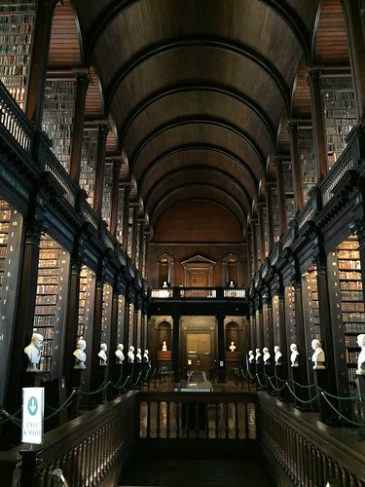
Theoretical Underpinnings
Dunn’s Sensory Processing Framework (Dunn, 2014)
Person Environment Occupation Model (Law et al, 1996)
Universal Design Principles

Slide 19
Key Principles
Diverse Sensory Experiences: Recognising that sensory experiences are unique to each individual, TCD Sense ensures that there isn't a one-size-fits-all approach. Instead, there are a variety of spaces created to cater to different sensory preferences and requirements.
Inclusivity and Accessibility: TCD Sense is built on the foundation of inclusivity. By considering various sensory needs, we aim to make spaces that are accessible and reflect the neurodiverse student and staff community here in Trinity.
A Holistic Approach: Trinity is a place where students and staff come to learn, work, socialise and relax. TCD Sense takes a holistic view of college life, by creating spaces for the broad range of activities that make up life here in Trinity.
Notes:
TCD Sense is an example of identifying an issue t
Student Engagement through Occupational Therapy Support & Disability Service
2018 & 2019: Library UX Study & Library Survey
Feb 2019: Sensory Audit Process carried out in Trinity Libraries and Science Laboratories
May 2019: Survey of Disabled Trinity Students based upon Dunn’s Sensory Processing Framework
January 2020: Working group was established between the Disability Service, Discipline of Occupational Therapy, as well as other stakeholders such as the Trinity Library, TCD SU, and the Science Faculty.
May 2020: Funding Proposal Submitted to the Higher Education Authority as a Strategic Initiative relating to Disability Services in Higher Education Institutions - €233,934 was allocated by the HEA to the project.
May 2021: Additional funding for the Sensory Project was sourced from the Disability Service Budget & Director of Student Services, & TCD SU Budget for Student Spaces.
January 2021 – Present: Activities within the project were planned across four interconnected strands.
hrough engagement with students, understanding it through research, and addressing it through co-production, innovation and partnership.

Slide 20
Key Principles
Adaptive and Evolving: As we learn more about sensory needs and gather feedback from the TCD community, TCD Sense will continue to evolve. Spaces might be adjusted, new spaces might be introduced, and old ones might be reimagined.
Education and Awareness: An integral part of TCD Sense is to raise awareness about the importance of sensory environments and how they impact well-being, learning, and daily functioning. It's about informing and educating the larger community on why these spaces matter.
A Collaborative Effort: TCD Sense is not an isolated initiative. It involves collaboration with students, faculty, and external experts to ensure the spaces created are genuinely beneficial.
Notes:
TCD Sense is an example of identifying an issue t
Student Engagement through Occupational Therapy Support & Disability Service
2018 & 2019: Library UX Study & Library Survey
Feb 2019: Sensory Audit Process carried out in Trinity Libraries and Science Laboratories
May 2019: Survey of Disabled Trinity Students based upon Dunn’s Sensory Processing Framework
January 2020: Working group was established between the Disability Service, Discipline of Occupational Therapy, as well as other stakeholders such as the Trinity Library, TCD SU, and the Science Faculty.
May 2020: Funding Proposal Submitted to the Higher Education Authority as a Strategic Initiative relating to Disability Services in Higher Education Institutions - €233,934 was allocated by the HEA to the project.
May 2021: Additional funding for the Sensory Project was sourced from the Disability Service Budget & Director of Student Services, & TCD SU Budget for Student Spaces.
January 2021 – Present: Activities within the project were planned across four interconnected strands.
hrough engagement with students, understanding it through research, and addressing it through co-production, innovation and partnership.

Slide 21
Project Structure

Slide 22
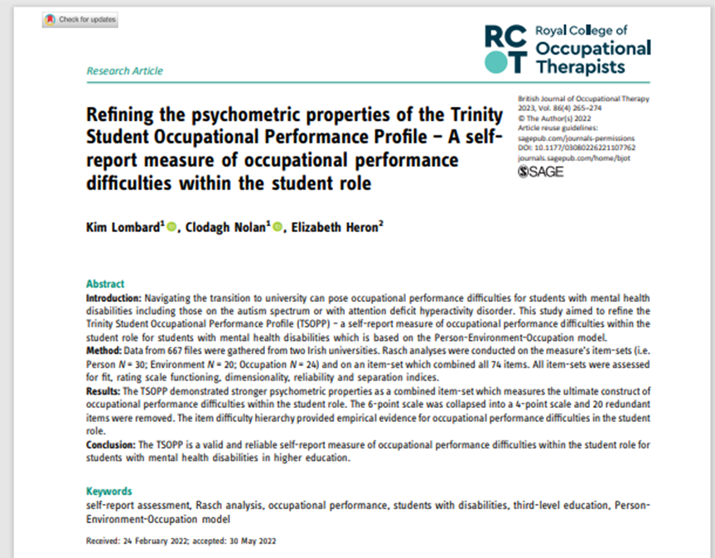
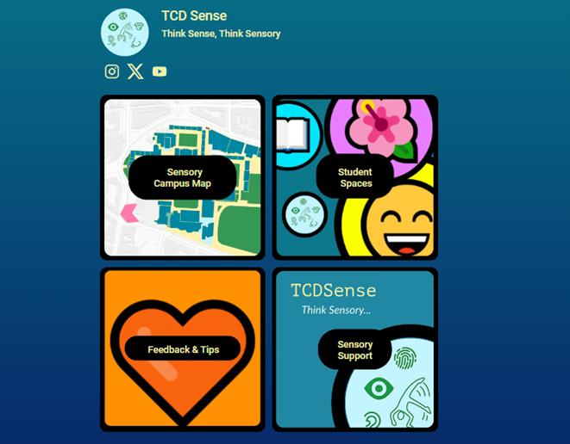
Strand One – Approaches within the Disability Service
Online resources – Beacons and Disability Service Website
Sensory-based question included in Disability Service needs assessment process
Occupational Therapy Process based upon Trinity Student Occupational Performance Profile (Lombard, Nolan, & Heron, 2022) Adolescent / Adult Sensory Profile (Brown and Dunn, 2002) & Sensory Environment Evaluation Tool (adapted with permission from Prof Winnie Dunn).
Sensory Training delivered to Disability Service staff
Sensory Tours for staff and students
Noise Cancelling Headphones and headsets & sensory resources provided to students from needs assessment / OT process.
Review of low distraction exam venues and purchase of suitable equipment

Slide 23
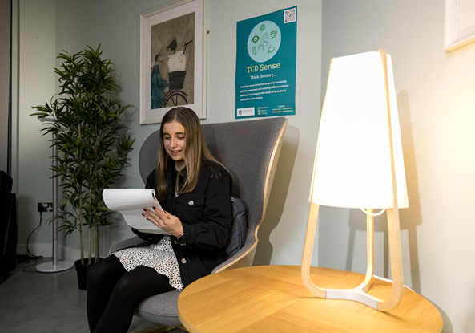
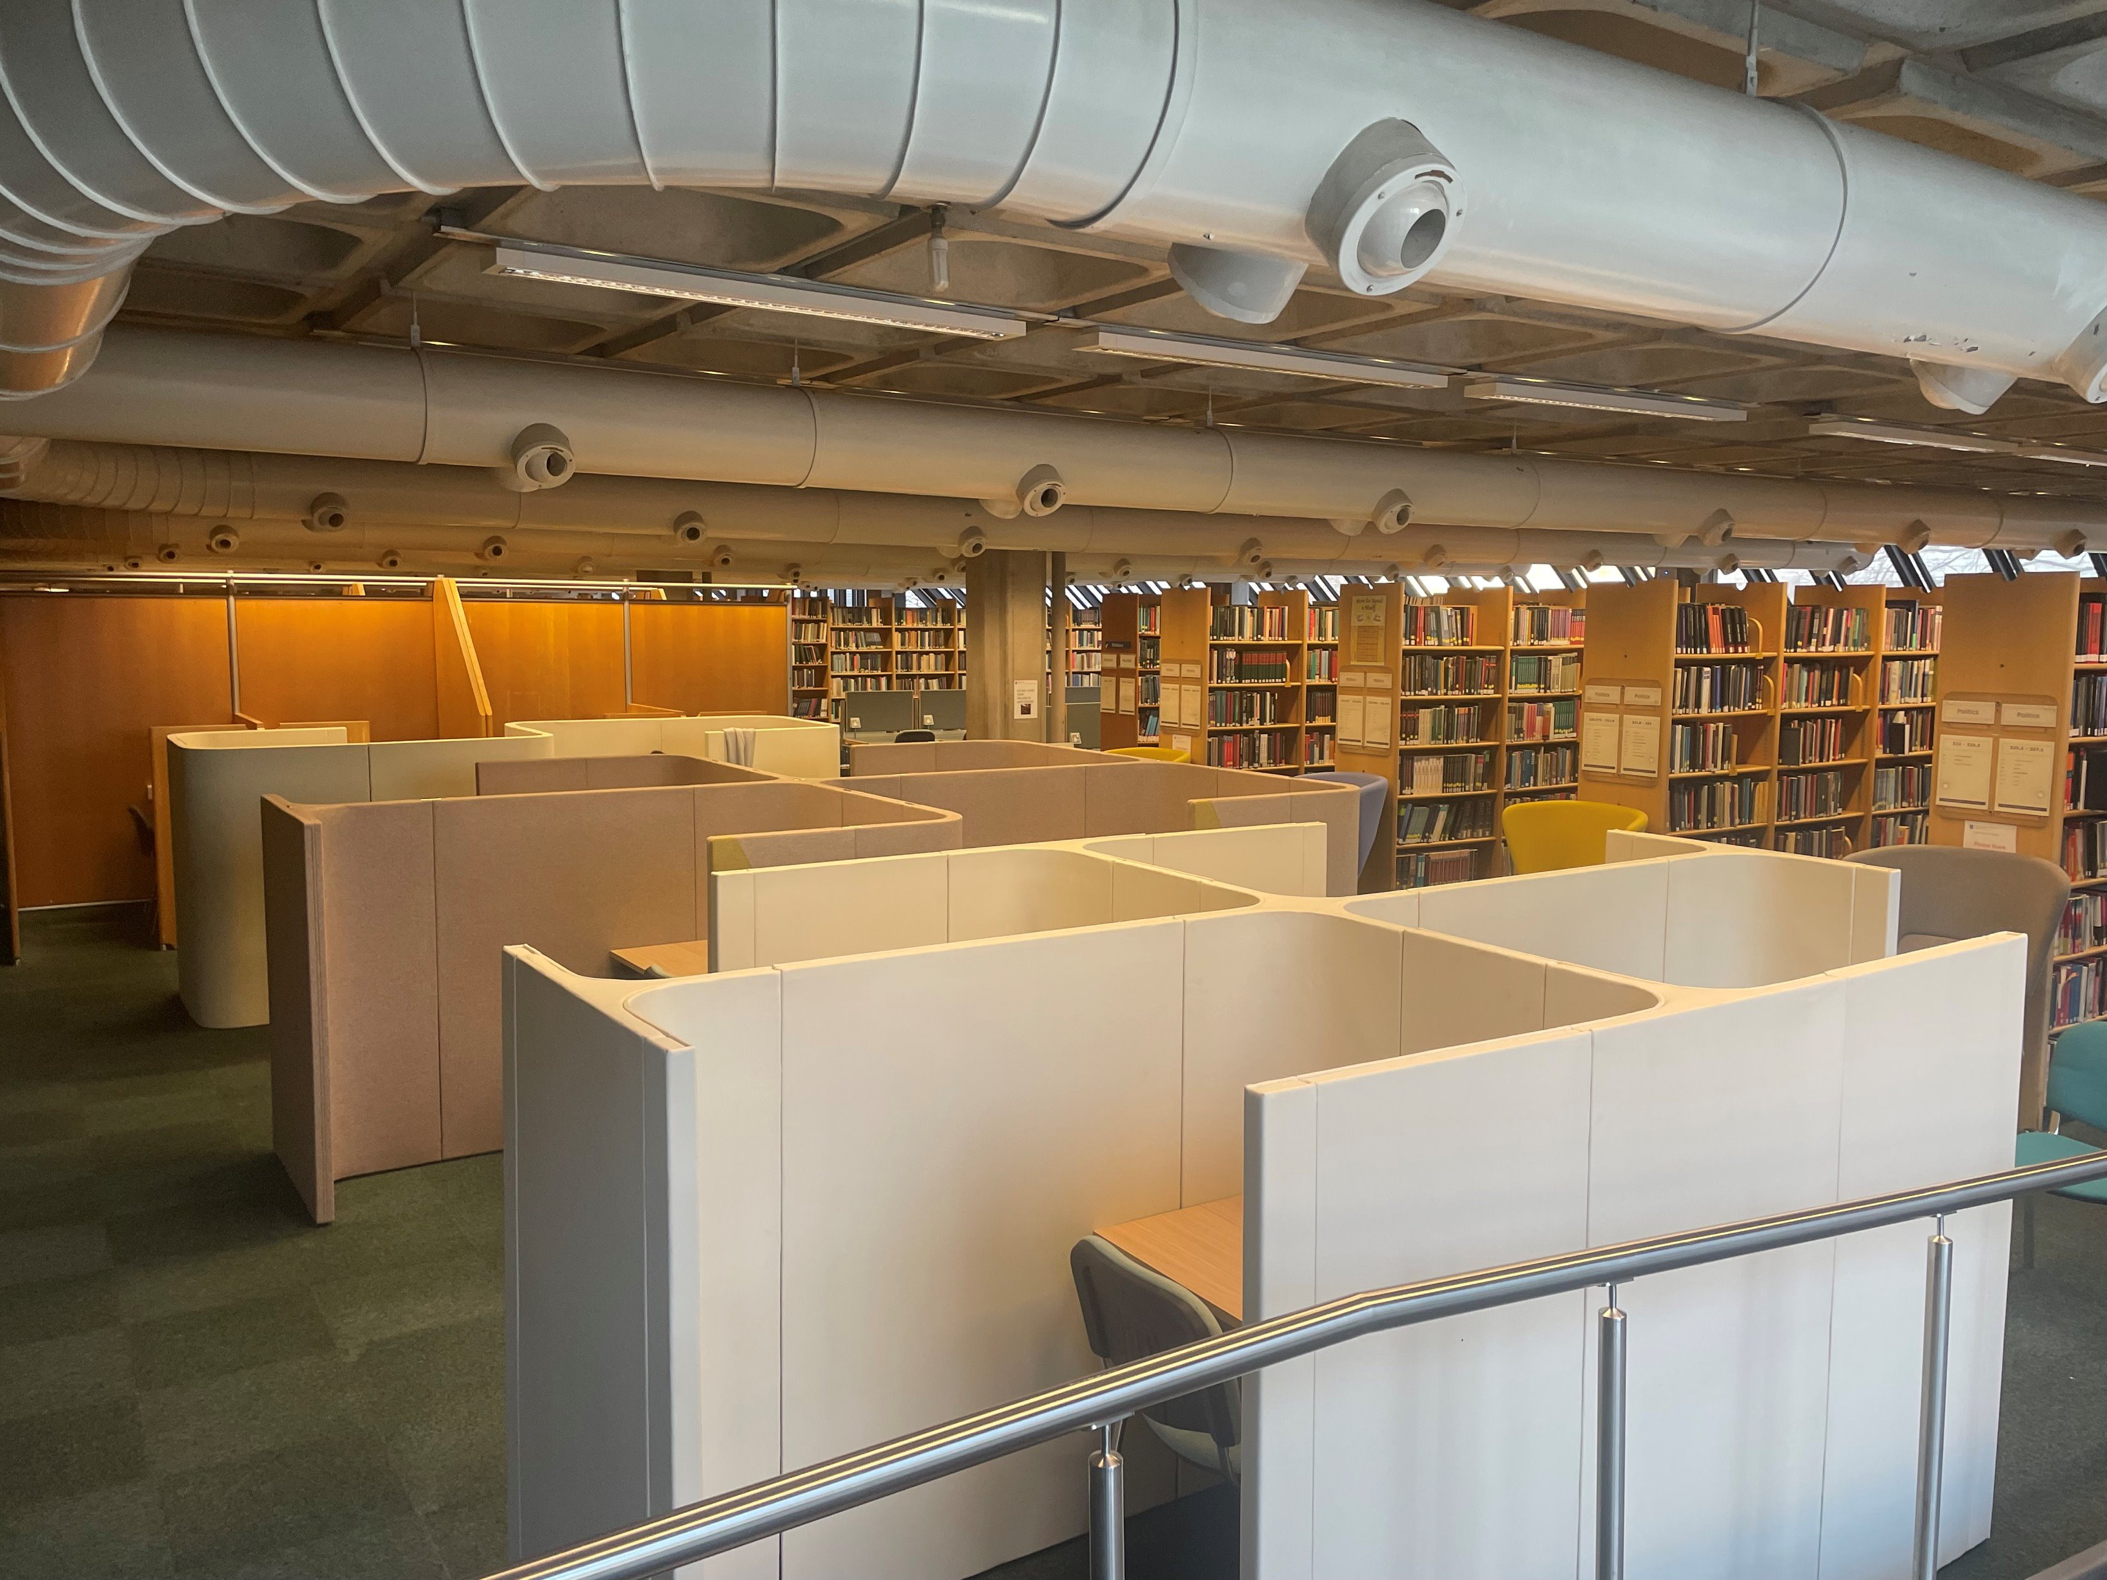
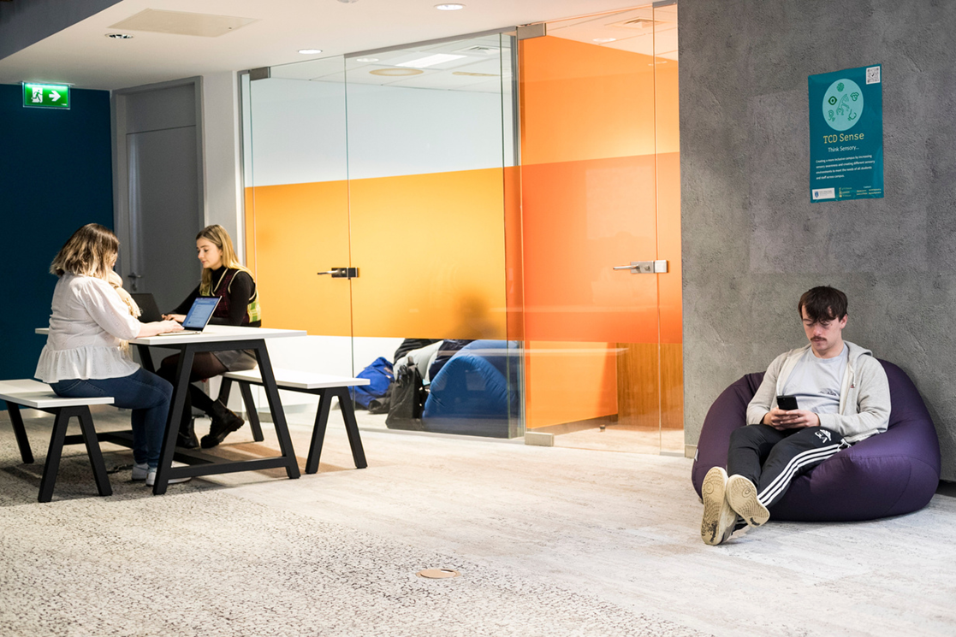
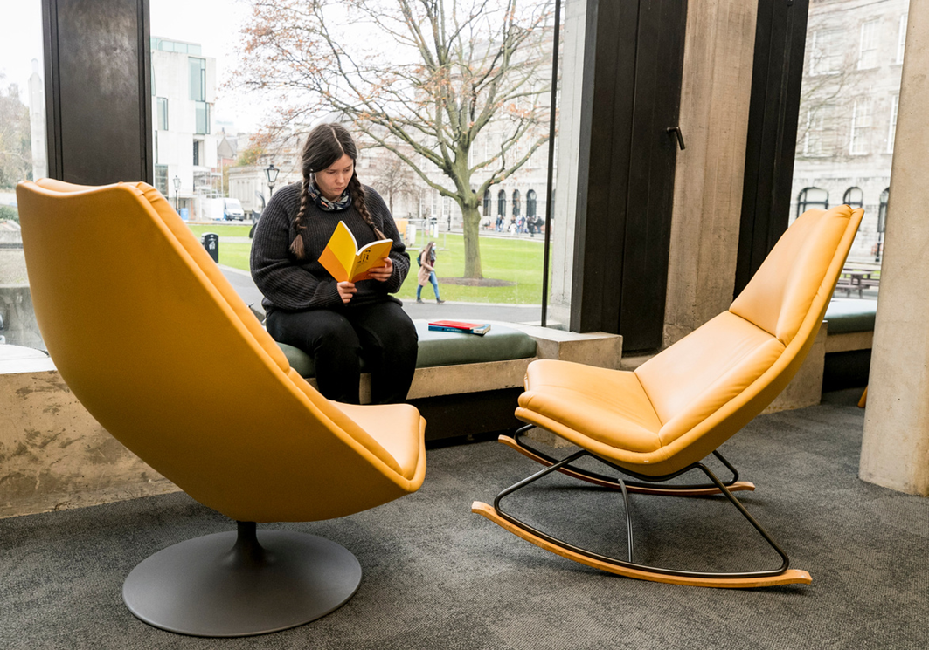
Strand Two – College Environment 21-22
Eleven Library Areas – used by 100’s students daily
Five social spaces developed with sensory design principles used by hundreds of students daily.
Three sensory respite spaces

Slide 24
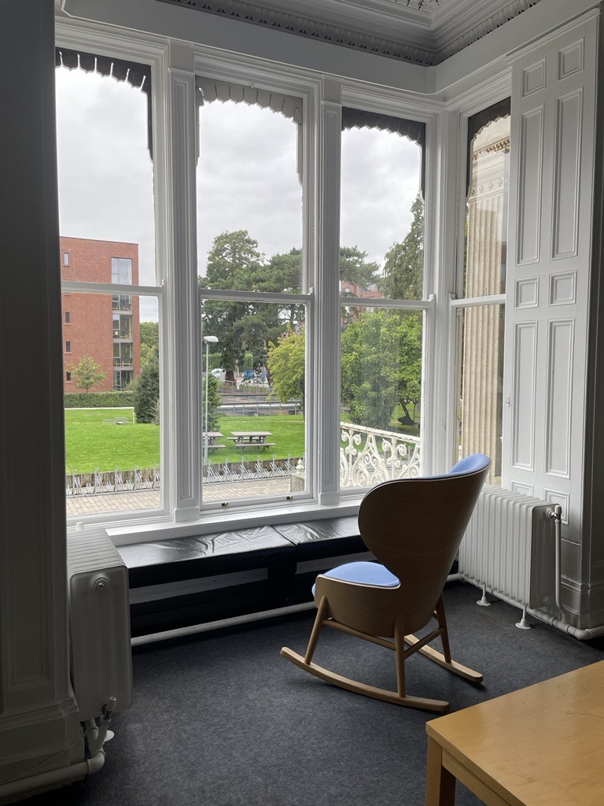
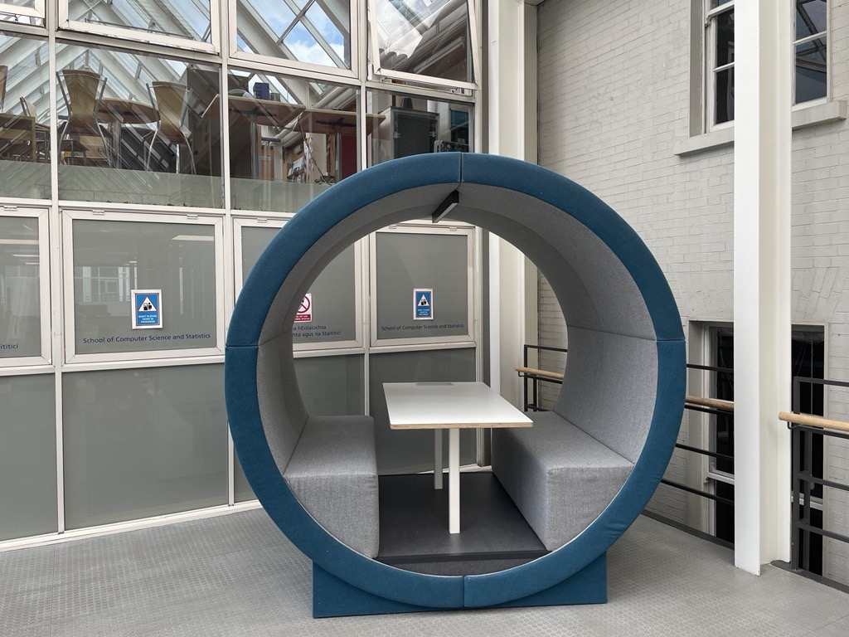
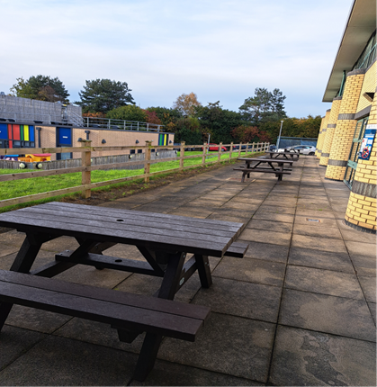
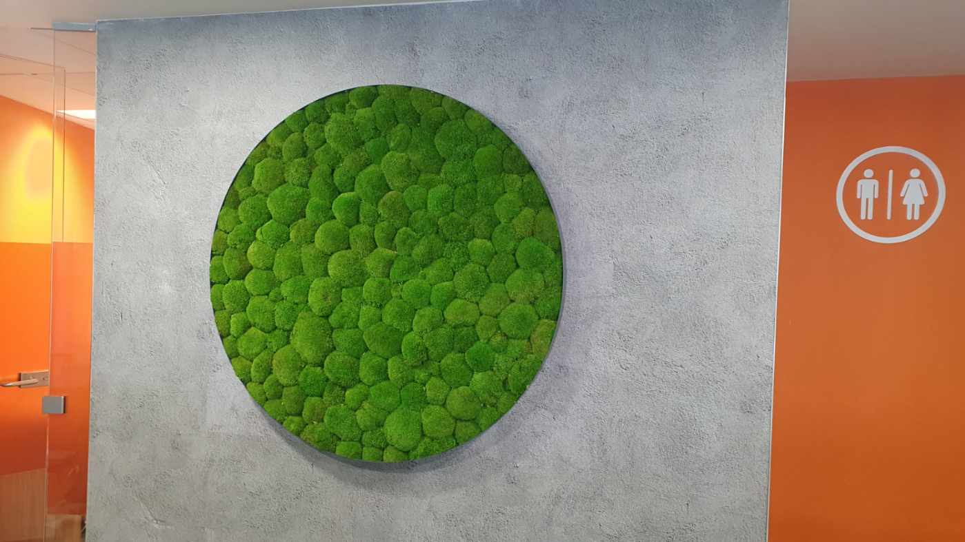
Strand Two – College Environment
Planting across areas of campus such as student spaces on campus & St James’s
Space set up in Oldham House in Trinity Hall
Outdoor seating in Trinity Centre Tallaght Hospital

Slide 25
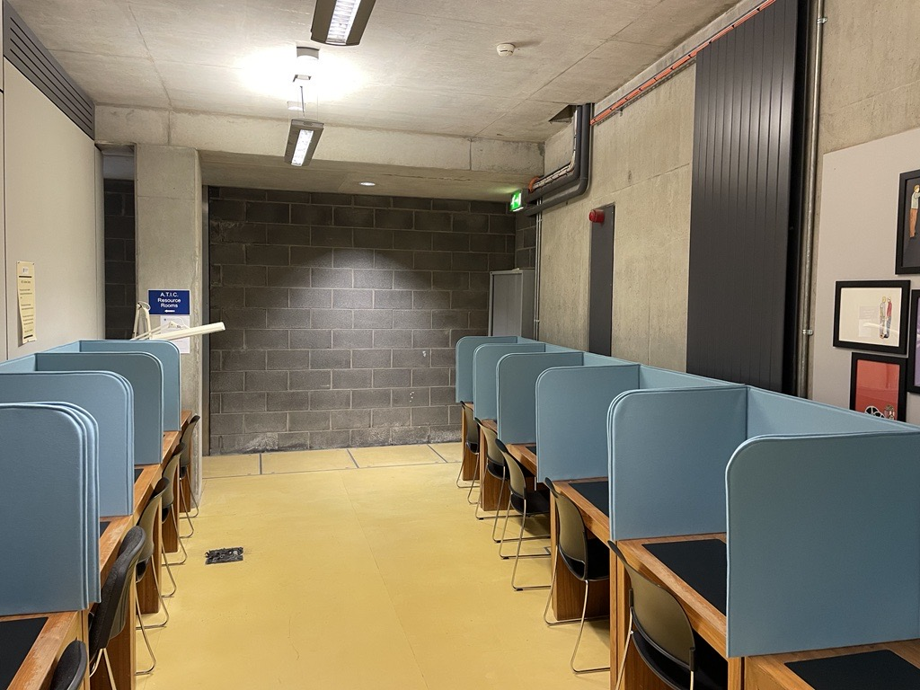
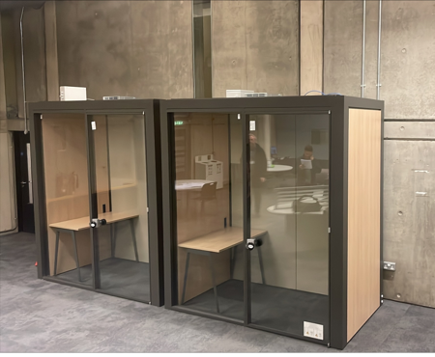
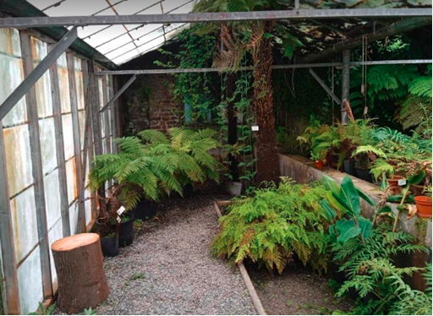
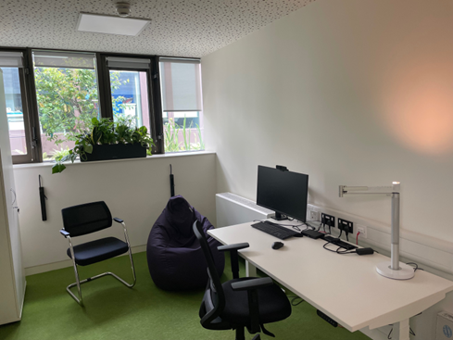
Strand Two – College Environment
Low Distraction Exam Venues – desktop screens
Desktop Screens & Headphones available throughout libraries
Outdoor Areas - Trinity Botanical Garden
Signage in the Library
Audit and development sensory spaces on consultancy basis

Slide 26
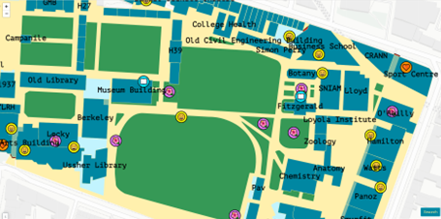
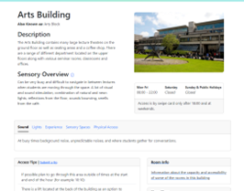
Strand 3: Student and Staff Awareness and Training on-going & Student Engagement
Communications plan with intern summer – social media
Sensory Map of Trinity
Sensory Trails in Trinity Botanical Gardens – online and in-person
Embed sensory aspect in peer-facilitated tours / orientation
Workshop delivered to departments, services, and students in PHS

Slide 27
Strand 4: Research & Partnerships
Research Connection with Disc. of Occupational Therapy in TCD.
Article British Journal of Occupational Therapy “Disabled Students perception of the sensory aspects of the learning and social environment within one Higher Education Institution." – May 2023.
Internships in TCD (sensory map, communications, resources and Botanic Gardens). – 27 applications from students
TCD Sense Volunteers Group, SU, JCR, Ability Co_op, Dublin University Neurodiversity Society
Further Collaborations – Trinity Botanical Gardens, Healthy Trinity Online Tool, Healthy Trinity, Trinity Centre St James’s User Group, Student 2 Student peer support.

Slide 28
Resources
Notes:
TCD Sense is an example of identifying an issue t
Student Engagement through Occupational Therapy Support & Disability Service
2018 & 2019: Library UX Study & Library Survey
Feb 2019: Sensory Audit Process carried out in Trinity Libraries and Science Laboratories
May 2019: Survey of Disabled Trinity Students based upon Dunn’s Sensory Processing Framework
January 2020: Working group was established between the Disability Service, Discipline of Occupational Therapy, as well as other stakeholders such as the Trinity Library, TCD SU, and the Science Faculty.
May 2020: Funding Proposal Submitted to the Higher Education Authority as a Strategic Initiative relating to Disability Services in Higher Education Institutions - €233,934 was allocated by the HEA to the project.
May 2021: Additional funding for the Sensory Project was sourced from the Disability Service Budget & Director of Student Services, & TCD SU Budget for Student Spaces.
January 2021 – Present: Activities within the project were planned across four interconnected strands.
hrough engagement with students, understanding it through research, and addressing it through co-production, innovation and partnership.

Slide 29
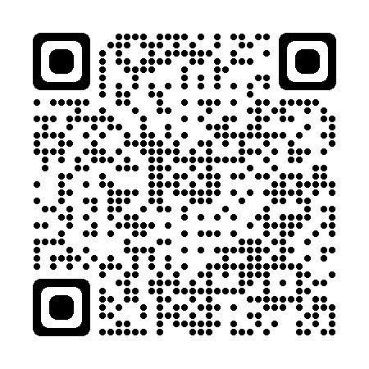
Scan QR Code to see more on TCD Sense
TCD Sense Beacons

Slide 30
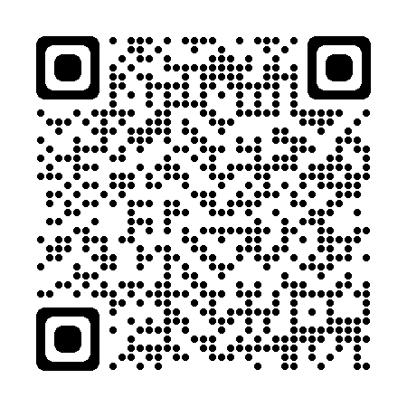
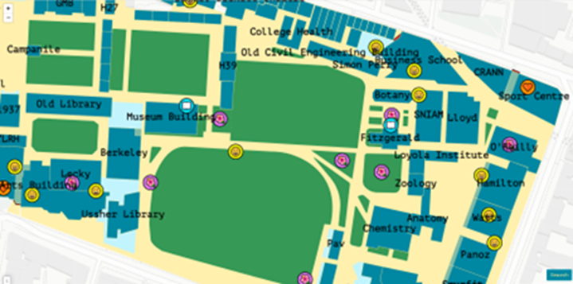
TCD Sense Map
TCD Sense Map

Slide 31
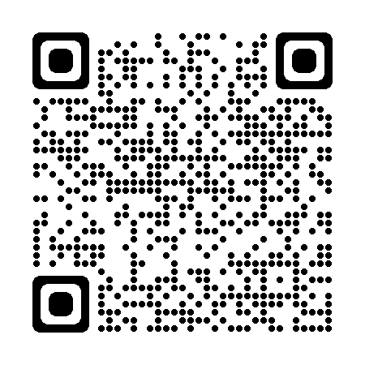
Trinity Botanical Garden Sensory Trail
The Sensory Trail

Slide 32
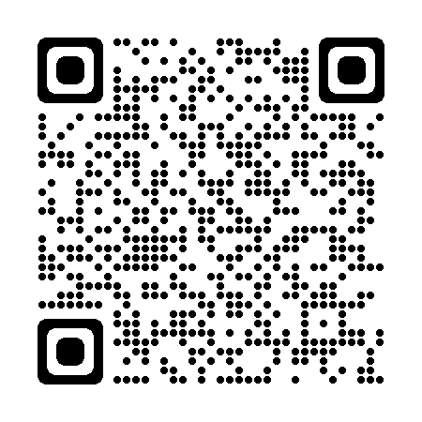
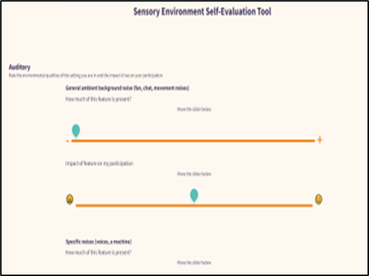
Sensory Evaluation Tool
Sensory Evaluation Tool

Slide 33
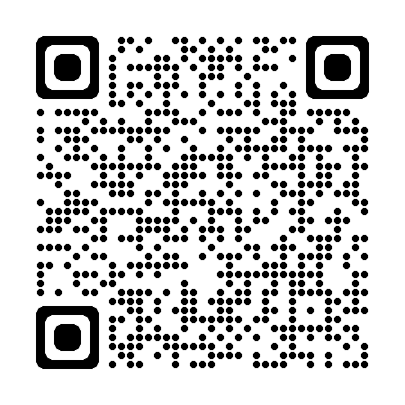
Disability Service Resources
Occupational Therapy:
Environmental assessment of learning, social and study spaces using Sensory Evaluation Tool
Individual Sensory Assessment using the Adult Adolescent Sensory Profile
If you would like to discuss any of these supports / resources, you can book a drop-in appointment
Based upon this assessment process, may recommend some of the following:
Sensory-based reasonable accommodations for examinations, lectures, work or placement.
Sensory Spaces for studying, socialising or respite.
Sensory Items and Furniture to best meet your sensory preferences.
TCD Sense Resources
Notes:
Sensory Ladders

Slide 34
Questions / Discussion / Reflections
What kind of initiatives have been developed with your institution?
What led to these being developed?
What has worked so far and why?

Slide 35
References
Brown, C., & Dunn, W. (2002). Adolescent/adult sensory profile. San Antonio, TX: Psychological Corporation.
Brown, C., Steffen-Sanchez,P., & Nicholson, R. (2019). ‘Sensory Processing’, in Brown, C., Stoffel, V. & Munoz, J. (ed.) Occupational Therapy in Mental Health, A Vision for Participation. Philadelphia, David, pp.323-341.
Clince, M., Connolly, L. & Nolan, C. (2016). Comparing and Exploring the Sensory Processing Patterns of Higher Education Students with Attention Deficit Hyperactivity Disorder and Autism Spectrum Disorder. American Journal Occupational Therapy, 70(2)
Dunn, W. (2001). The sensations of everyday life: Empirical, theoretical and pragmatic considerations (Eleanor Clarke Slagle Lecture, 2001). American Journal of Occupational Therapy. 55(6); 608-620.​
Dunn, W. (2014). Sensory Profile 2: User's Manual: Psych Corporation
Gearhart GC and Bodie GD (2012) Sensory-processing sensitivity and communication apprehension: Dual influences on self-reported stress in college students. Communication Reports 25: 27–39
Law, M., Cooper, B,. Strong, S., Stewart, D., Rigby, P. & Letts, L. (1996). The Person-Environment Occupation Model: A transactive approach to occupational performance. Canadian Journal of Occupational Therapy. 63(1):9-23.
Johnson ME and Irving R (2008) Implications of sensory defensiveness in a college population. The American Occupational Therapy Association Sensory Integration Special Interest Section Quarterly 31: 1–3.
Nolan, C., Doyle, J.K., Lewis, K., & Treanor, D. (2022). Disabled Students’ perception of the sensory aspects of the learning and social environments within one Higher Education Institution. British Journal of Occupational Therapy.

