Slide 1
Scanmarker
James.wright@aventido.com

Slide 2
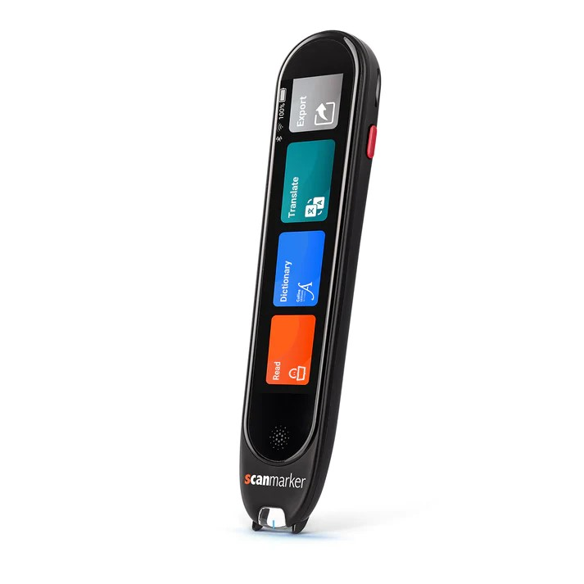
What is Scanmarker?
Reading Pen
OCR (Optical Character Recognition)
Reads any text aloud
Translation into 100+ languages
Enhances reading understanding

Slide 3
Why use a Reading Pen?
Simple to use
Portable
Multiple ways of processing information (Text-To-Speech/ Dictaphone)
ESL or MFL students (Translation)
Capturing Resources on the move (Field trips, Libraries and in the classroom)

Slide 4
Who can benefit from a Reading Pen?
Dyslexia
Reading difficulties: Dyslexia affects reading fluency, accuracy, and comprehension.
Slow reading rate: Reads at a slower pace due to decoding effort.
Comprehension challenges: Difficulty understanding written text.
Support strategies: Multisensory approaches, phonics, repeated reading.

Slide 5
Who can benefit from a Reading Pen? Visual Impairment
Challenges with print: Difficulty in seeing and processing printed text due to reduced vision.
Visual acuity: Impacts the ability to see small details, such as letters and words.
Fatigue: Strain from attempting to read with limited vision can lead to fatigue quickly.

Slide 6
Who can benefit from a Reading Pen? Language Learners
Vocabulary: Lack of vocabulary knowledge can hinder comprehension and fluency.
Grammar: Difficulty with English grammar can affect understanding of written text.
Pronunciation: Challenges in pronouncing English words correctly can impact reading fluency.
Instant translation: Reading pens can translate words or sentences into the user's native language.

Slide 7
Scanmarker Pro
Text-To-Speech
Dictionary
Dictaphone Audio Recorder
Favourite words or sentences
Spoken Translation
Online or Offline
Rechargable Battery
WIFI and Bluetooth enabled
1000 minutes of audio and text storage

Slide 8
Live Demo

